Slide 1
Overview of the FLW situation and approach to FLW reduction in the region Key elements of a successful FLW strategy
Myriam ANNETTE
International Consultant, SAVE FOOD - Initiative on Food Loss and Waste Reduction
Regional Office for Europe and Central Asia, Food and Agriculture Organization

Slide 2
We are losing
1.3 billion ton
1 / 3

Slide 3
What is Food Loss and Food Waste?

Slide 4
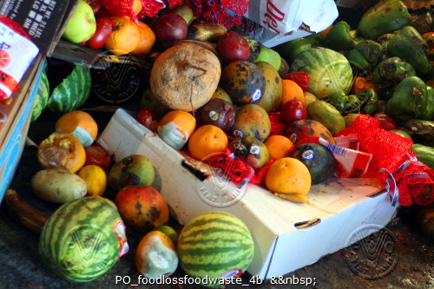
Global Food Loss and Waste
Globally, around 14 percent of food produced is lost from the post-harvest stage up to, but excluding, the retail, food service and household stages (FAO, 2019 – SOFA report).
17 percent of total global food productions is wasted (11% in households, 5% in food service and 2% in retail).
931 million tonnes of food is wasted each year. Nearly 570 million tonnes of this waste occurs at the household level (global average of 74 kg per) (UNEP, 2021 - Food Waste Index Report 2021).

Slide 5
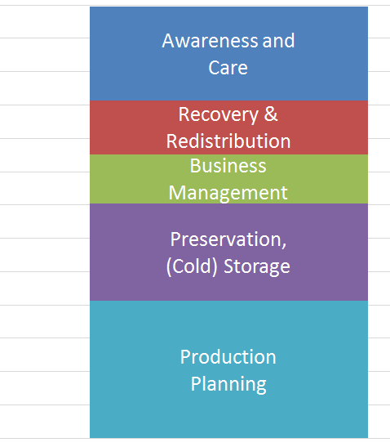
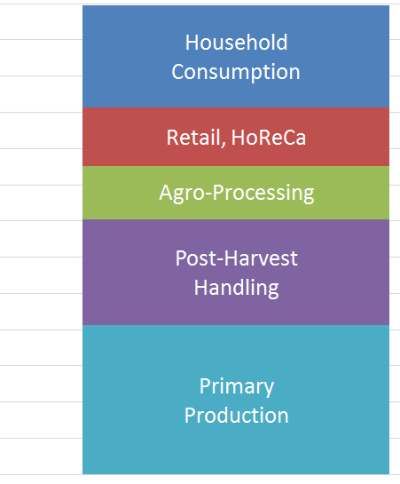
Solutions to Food Loss and Waste
Global Food Loss and Waste (million tons) in the Food Supply Chains
Areas of Action to Reduce Losses

Slide 6
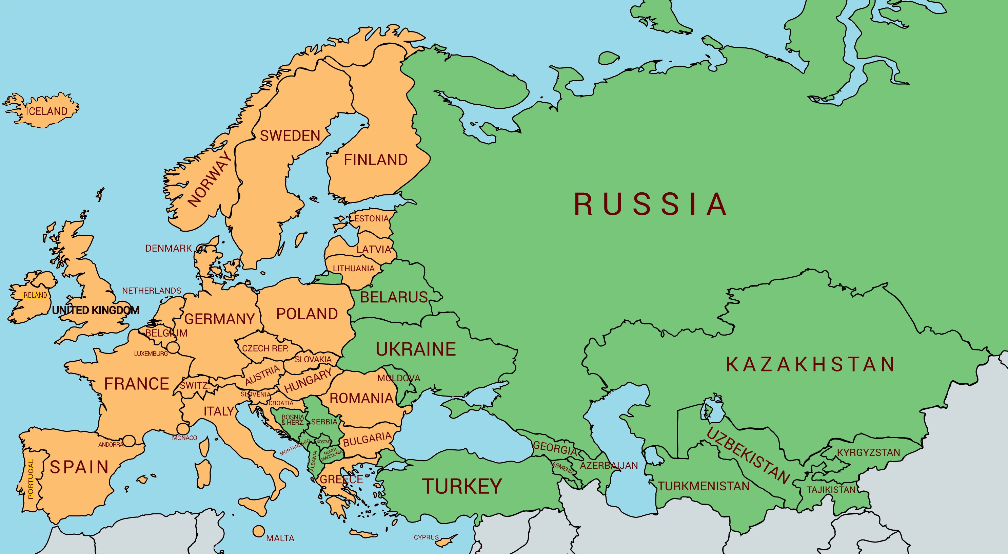
FLW Reduction in Europe and Central Asia: Programme overview and approach to implementation
Work areas
Develop national strategies and actions plans
Strengthen national capacities for FLW measurement and reporting systems
Promote and enhance food recovery and redistribution networks
Knowledge management and capacity development
Raise awareness and behaviour change
Collaborations and partnerships development

Slide 7
Main causes of FLW in the region and priorities
Causes
Lack of accurate data on FLW – quantitative, qualitative
Unfavourable investment climate
Trade and taxation policies
Lack of awareness of the complexity of FLW
Value chain coordination and supply logistics
Confusion about food safety and quality standards
Fragmentation of agri-food production: slow pace of consolidation into commercial farms
Consumer preferences
Priorities – Elements of a FLW Strategy
Facilitate an enabling policy and regulatory environment
Support research and knowledge dissemination
Improve the performance of value chains
Raise awareness and communication
Develop partnerships
Promote and enhance food recovery and redistribution systems
Divert FLW to an economically productive non-food use

Slide 8
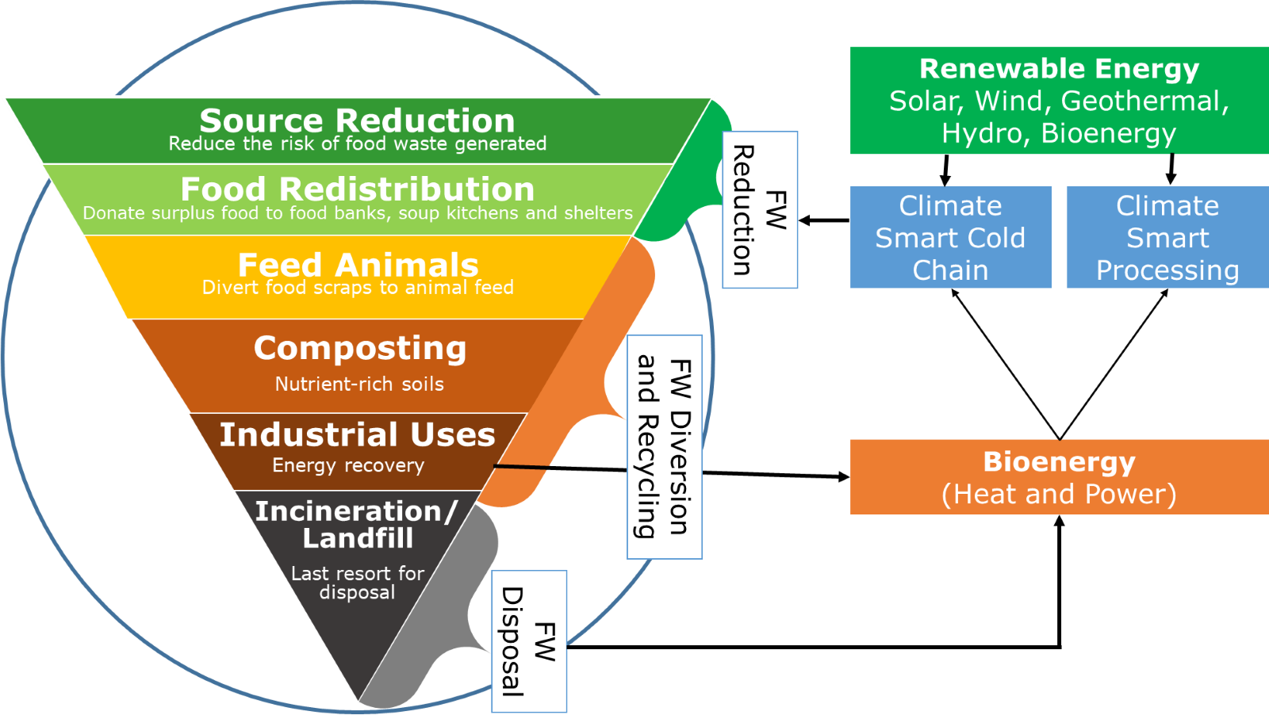
Food Loss and Waste Management Hierarchy

Slide 9
Resources
The State of Food and Agriculture (SOFA) 2019 Moving forward on food loss and waste reduction; http://www.fao.org/publications/sofa/2019/en/
Voluntary Code of Conduct for Food Loss and Waste Reduction, Conference, FAO; http://www.fao.org/3/nf393en/nf393en.pdf
2018: Overviews of food systems and agro-industry, value chains, and food loss and waste in the countries of Eastern Europe and Central Asia; http://www.fao.org/3/i9788en/I9788EN.pdf
Food recovery and redistribution a practical guide for favourable policies and legal frameworks in Europe and Central Asia; http://www.fao.org/uploads/media/Food_recovery_and_redistribution_guide.pdf
E-learning Course on the SDG Sub-indicator 12.3.1.a – Food Loss Index​
https://elearning.fao.org/course/view.php?id=605​
E-Learning Course on the Case Study Methodology​
http://www.fao.org/elearning/#/elc/en/course/FLA​
Save Food – Global Initiative on Food Loss and Waste Reduction; http://www.fao.org/save-food/en/
http://www.fao.org/3/CA1475EN/ca1475en.pdf

Slide 10
THANK YOU FOR YOUR ATTENTION!

