Slide 1
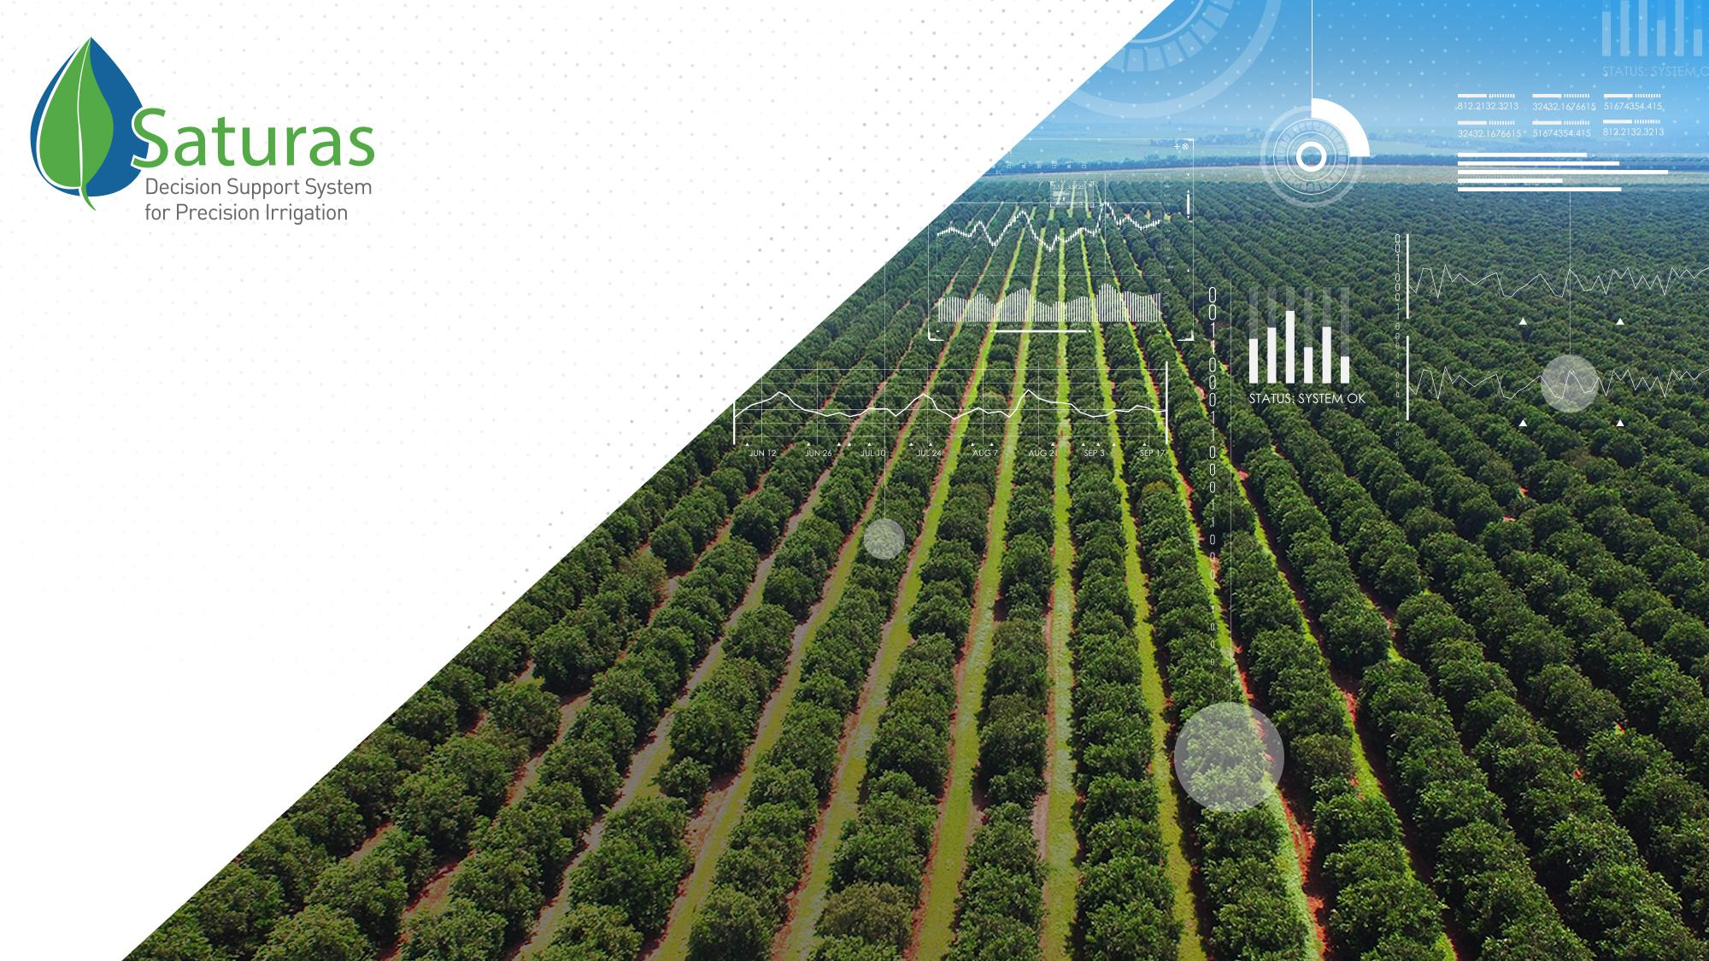
Advanced Decision Support System (DSS)
for Optimal Irrigation
Avi Stein
CMO

Slide 2
Meeting the Global Food Challenge
more than
9 billion
people
cutting-edge technologies
to maximize crop yields and minimize the use of resources
Saturas’ precision irrigation systems: efficient water use to address the need
will require
70% increase
in global food supply

Slide 3
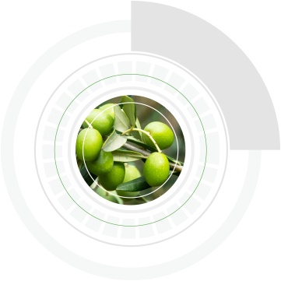
Precise Irrigation – Lack of Cost Effectives Tools
Yield vs. Irrigation
Farmers don’t irrigate when the plant is stressed,
They irrigate when they are stressed.

Slide 4
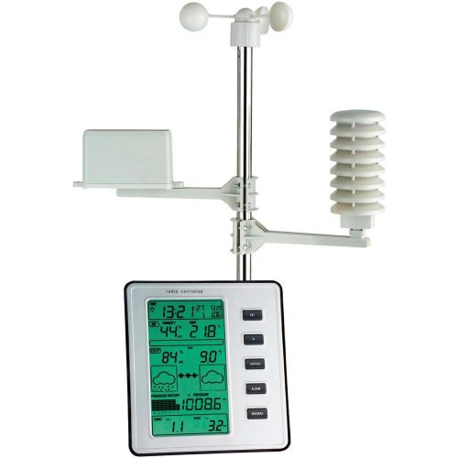
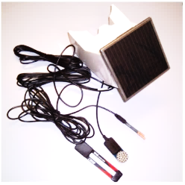
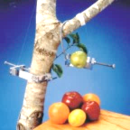
Current Solutions Are Limited
  Climate-based
  Measures basic water needs only, based on empirical data
  Soil-based
  High variability, limited accuracy
  Plant-based
  Indirect indicators, difficult interpretation, high variability, expensive

Slide 5


Slide 6


Slide 7
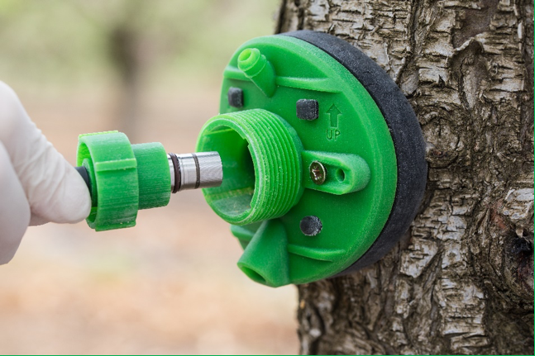
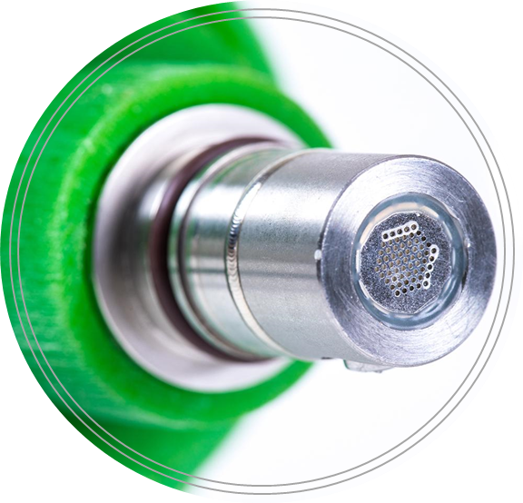
Saturas’s StemSense™
Saturas, aims to make SWP measurement frequent, easier, automated and affordable.
Miniature, tree-embedded sensor that continuously measures Stem Water Potential

Slide 8
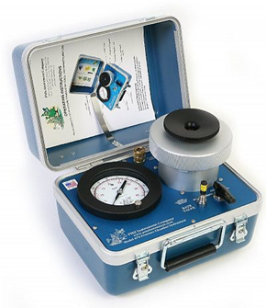
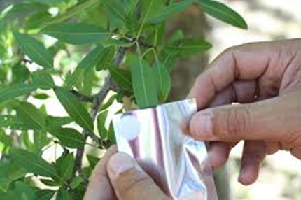
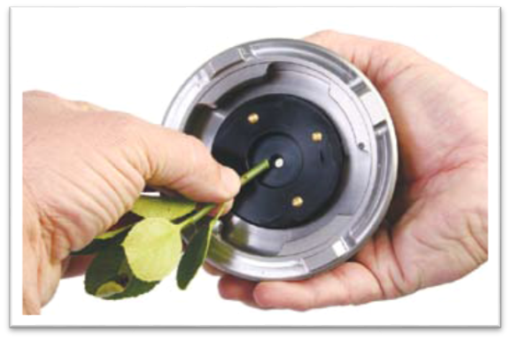
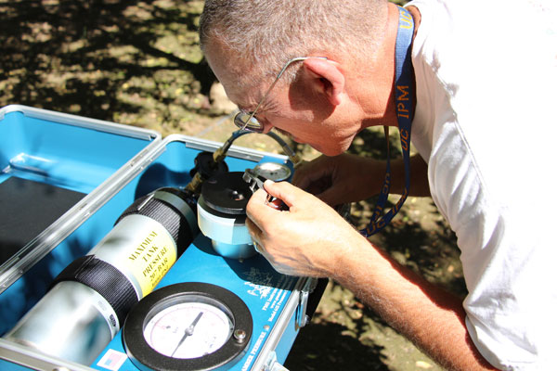
The Opportunity
Currently, the only method of measuring SWP is by using a labor intensive manual device (“pressure chamber”)
Stem Water Potential (SWP) is scientifically recognized as the most reliable measurement of water stress and an important practical tool for irrigation management

Slide 9
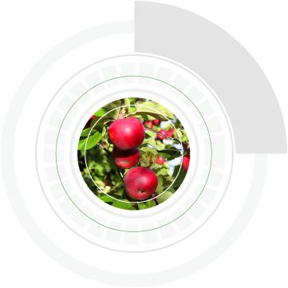
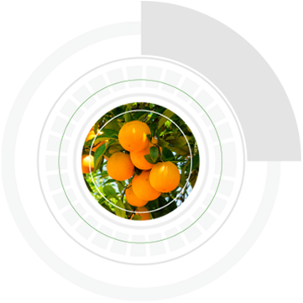
Saturas’s Value Proposition
Saves water 10% - 20%
Saves energy & Reduces Carbon footprint
Increases yield
5% - 30%
Improves
quality
Just for almonds in California, we can save $ 250M annually on water and increase profitability by additional $270M from yield increase

Slide 10
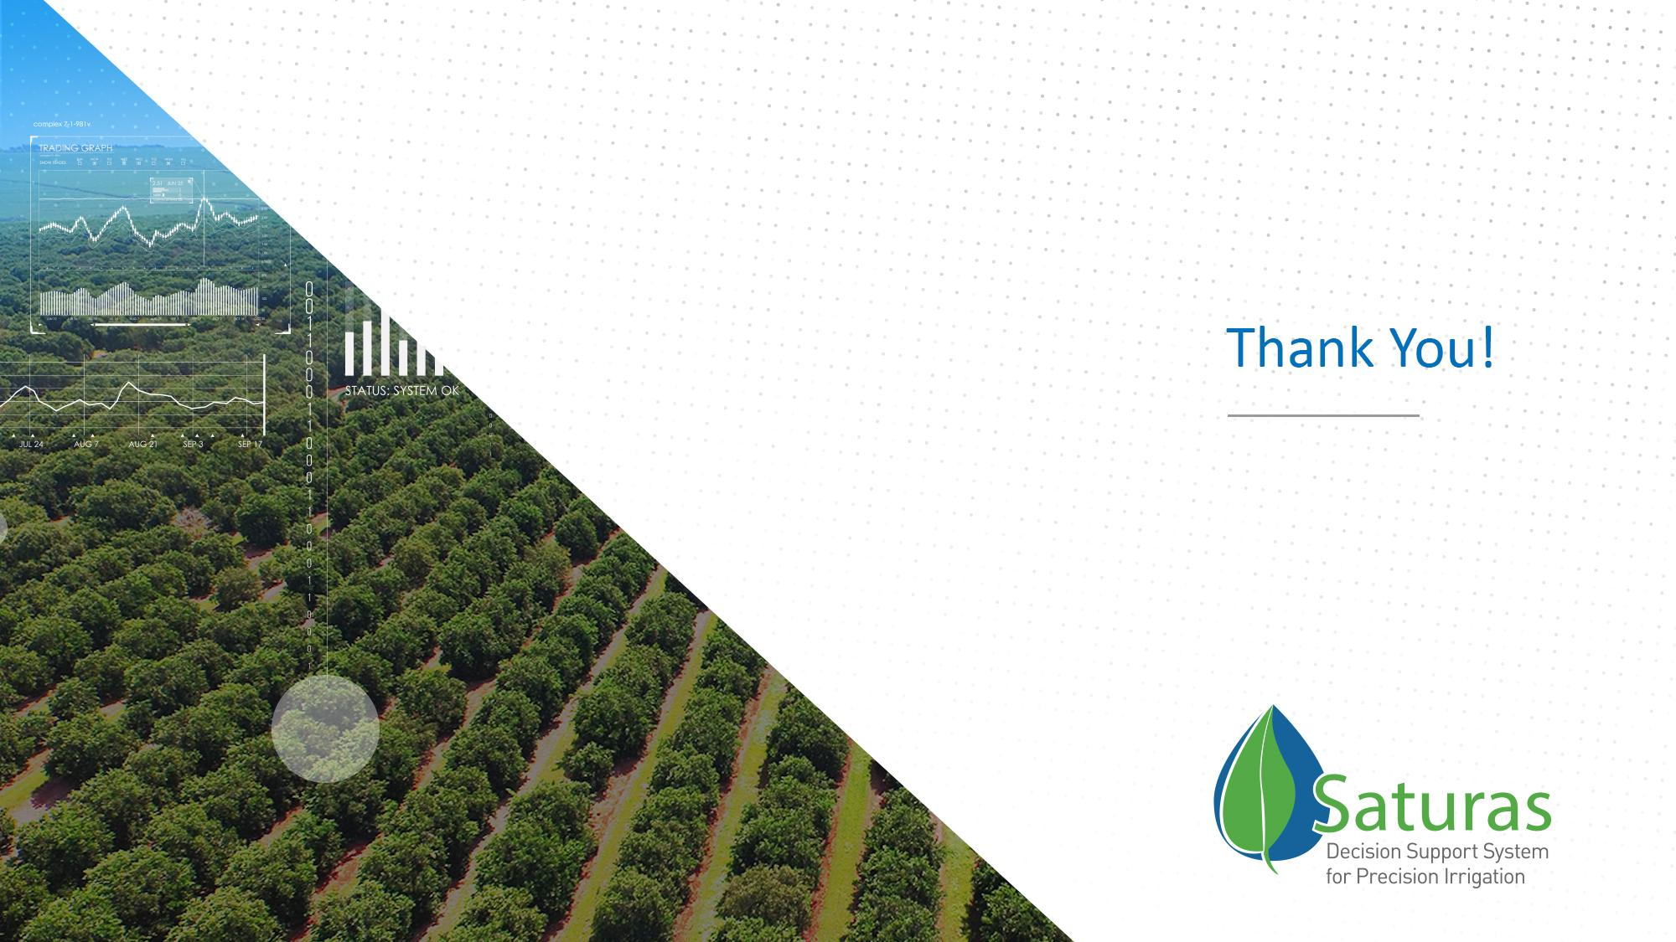
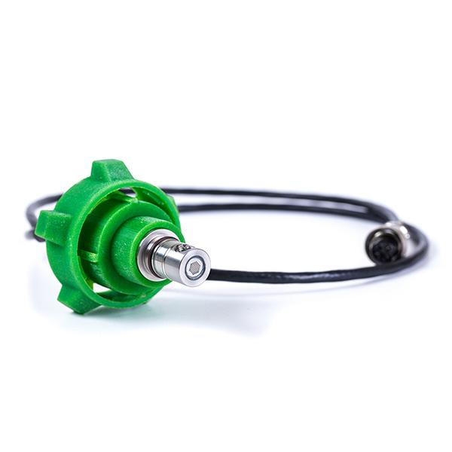
  Avi Stein, CMO
  Mobile +972.54.673.7499
  E-mail avi@saturas-ag.com

