Slide 1

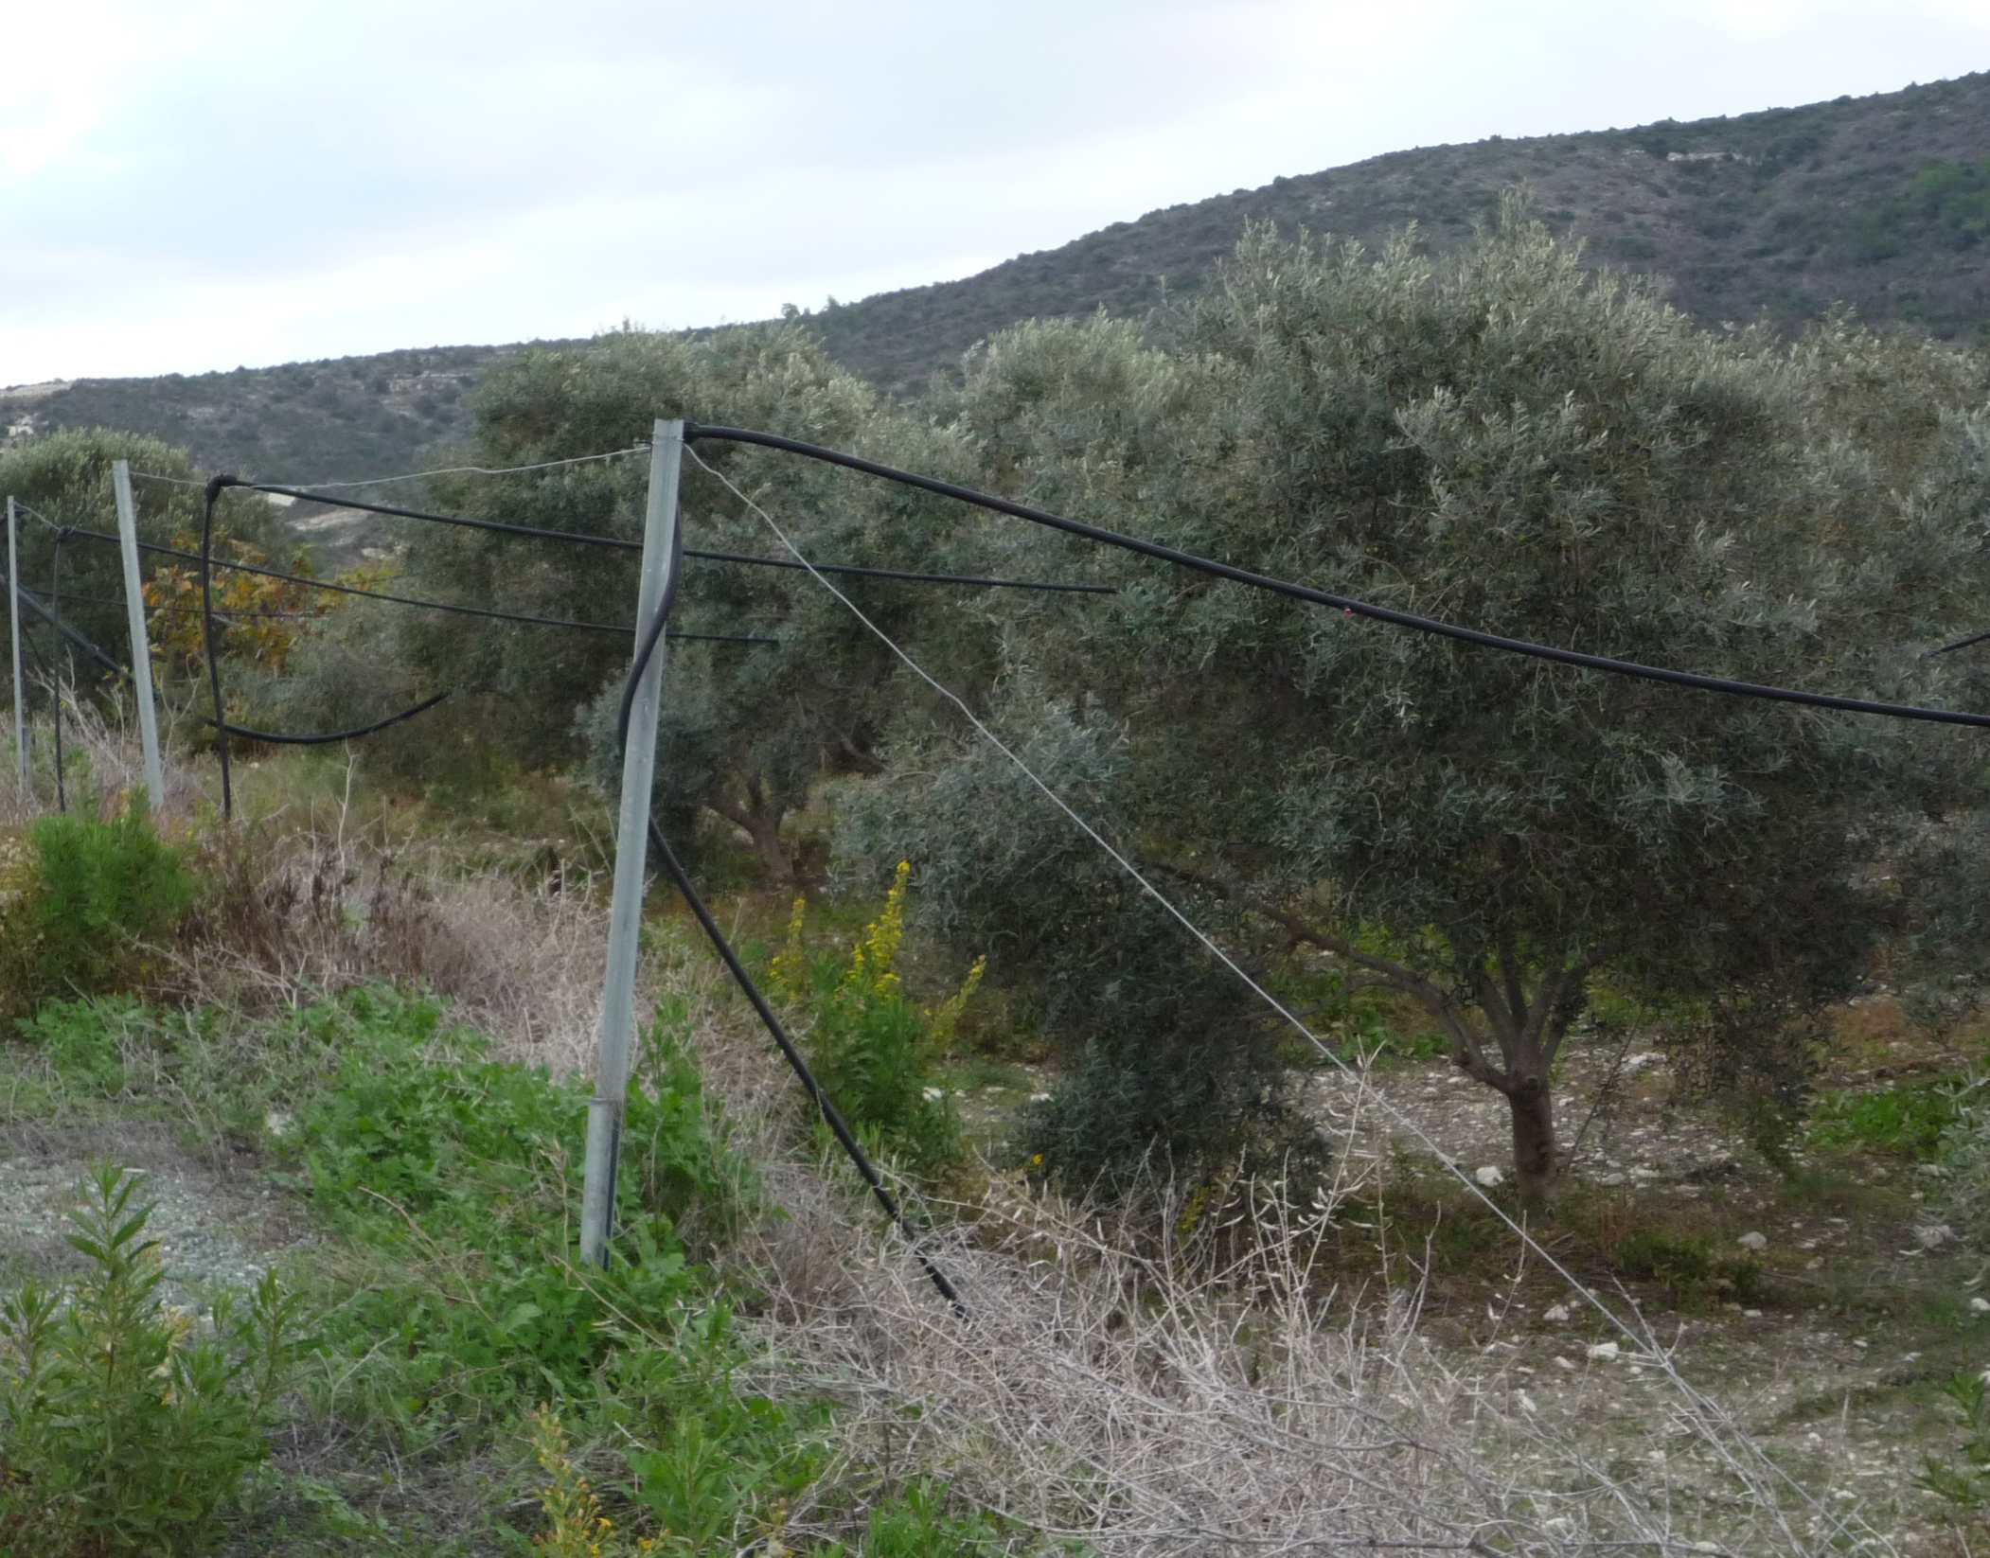

Health risks resulting from the use in irrigation of water contaminated by viruses; impact of irrigation modes
Pierre Renault
INRA – UMR 1114 EMMAH (Avignon, France)
(pierre.renault@inra.fr, +33 (0)4.32.72.22.23)

Slide 2
The importance of foodborne transmission of viral Acute Gastro-Enteritis (AGE) diseases

Slide 3
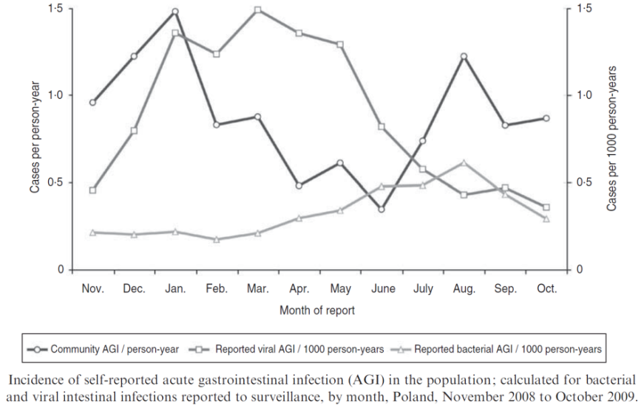
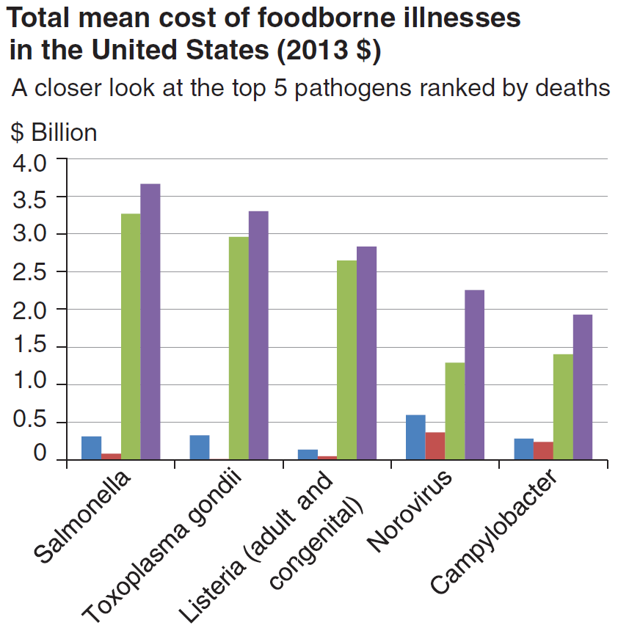

Acute gastroenteritis: aetiology, frequency, cost
AGEs affect one third of the French population each year
Chikhi-Brachet et al. (2002)
Various AGE aetiologies:
Viruses;
Bacteria;
Unicellular parasites;
Undefined
59%
39%
2%
Viral AGE
in the USA
Bacterial AGE
Esseili et al. (2012)
In Poland
Baumann et al. (2012)
$413 per case of Norovirus AGE
The cost of AGE and other foodborne illnesses depends on the aetiology, the subject age and the geographical area
Hoffmann et al. (2015)
Norovirus AGEs represent 58.2% of foodborne illness cases in the USA

Slide 4
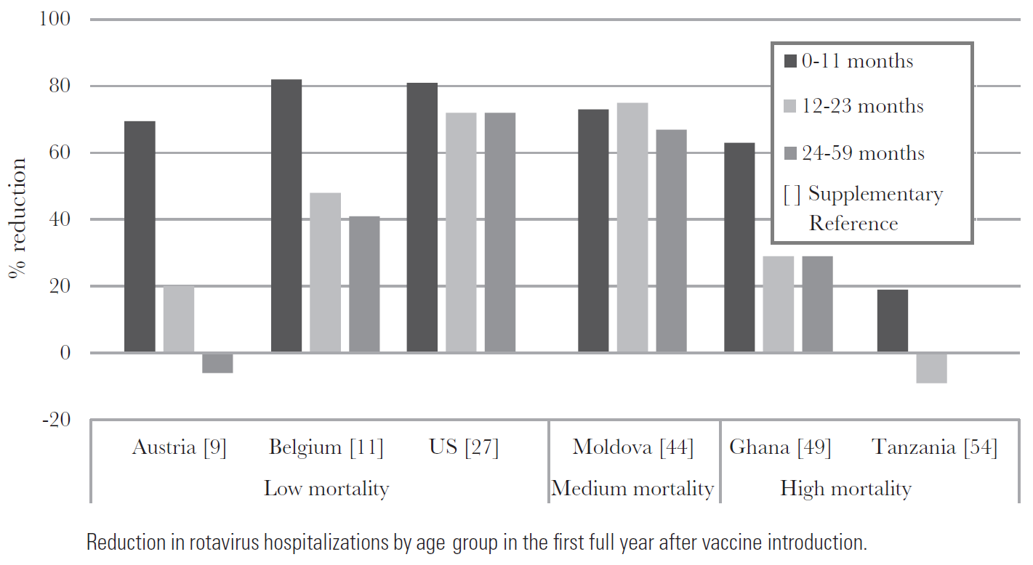
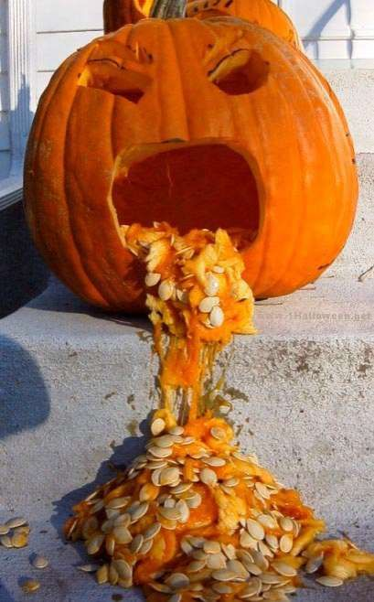
Viral AGEs: their importance and specificities
Various viruses: rotavirus, norovirus, sapovirus, enterovirus (echovirus, coxakievirus), adenovirus ...
Before vaccination, the most important for young children
Possible clinical symptoms:
diarrhoea,
vomiting,
nausea,
abdominal pain,
(fever) …
Causative agents of most of viral AGE (40-80%) … whatever the subject ages.
Burnett et al. (2017)
Noroviruses: 200 000 deaths per year worldwide due to dehydration and malnutrition complications, especially for the young, elderly and immunocompromised
Mallory et al. (2019)

Slide 5
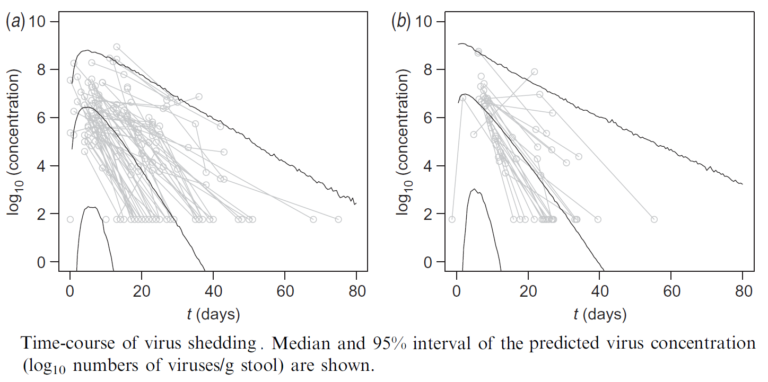
Noroviruses: shedding and infectious dose
Norovirus shedding with faecal excretion:
Up to 10⁺¹² viruses per gram of faeces;
Shedding starts before the onset of clinical symptoms, and stops well after the end of these symptoms;
Symptomatic subjects (70%)
Asymptomatic subjects (30%)
Teunis et al. (2015)
Low infectious dose: ∼18 to 1000 viral particles
Teunis et al. (2008)

Slide 6
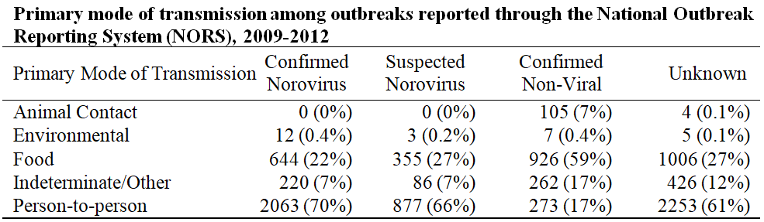
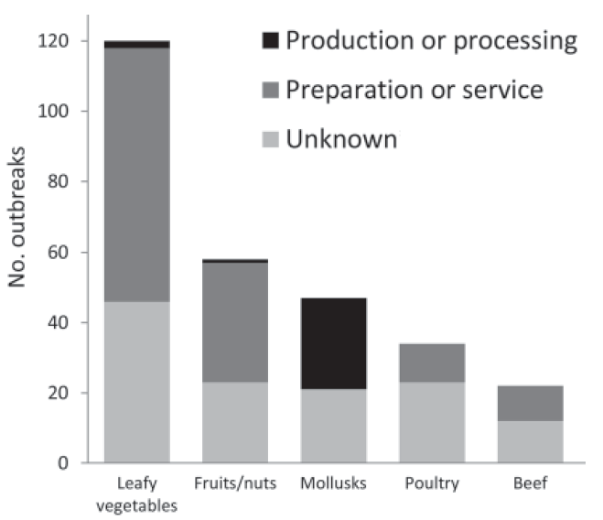
Direct / indirect transmission of NV in the USA
Primary mode of transmission of NV infections in the USA:
Lively et al. (2018)
Relative contributions of various foods to NV foodborne outbreaks
in the USA.
Leafy vegetables > Fruits/nuts > Mollusks
Hall et al. (2012)

Slide 7
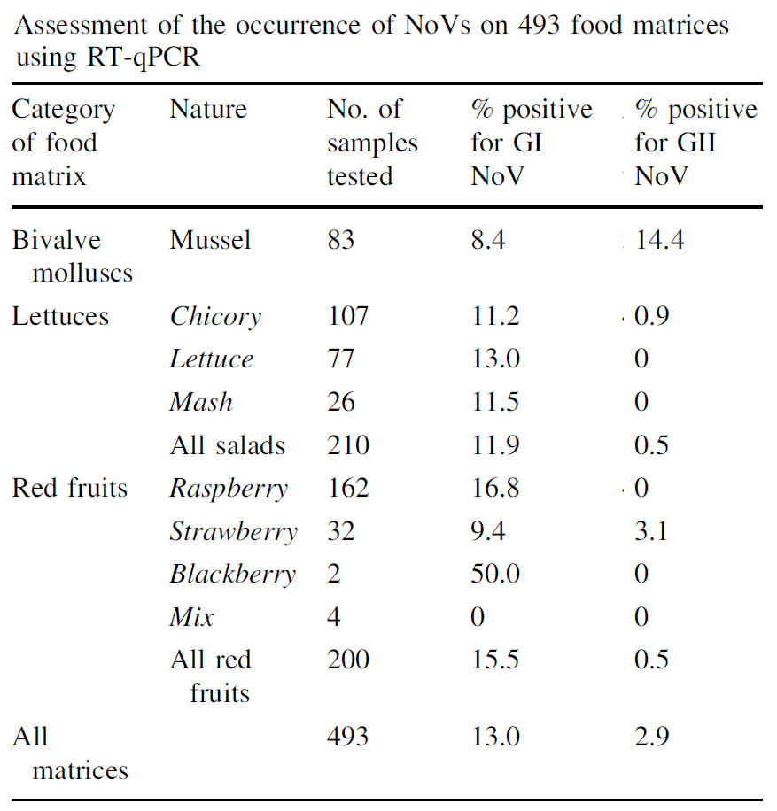
Prevalence of NV contamination in France
Frozen marketed mussels supplied by French importers or recovered from different retail outlets.
From Chile, Pacific Ocean, Spain, New Zealand, North West Atlantic Ocean, Vietnam, Ireland.
Fresh lettuces provided by industrial producers.
From Spain, Italy, Belgium, France and Tunisia.
Frozen berries provided by industrial producers.
From Serbia, Chile, Bulgaria, Poland, Spain, Morocco, Turkey and France;
Loutreul et al. (2014)

Slide 8
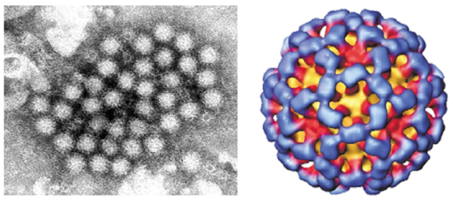
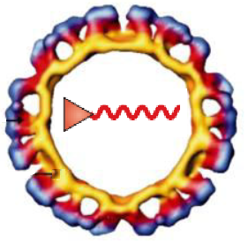
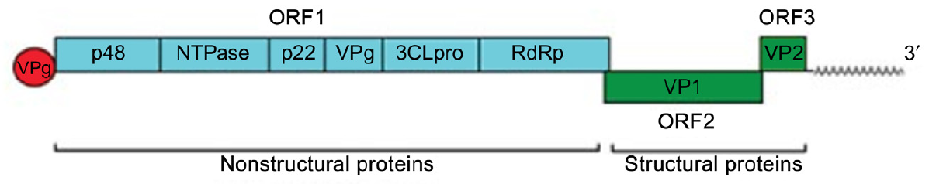
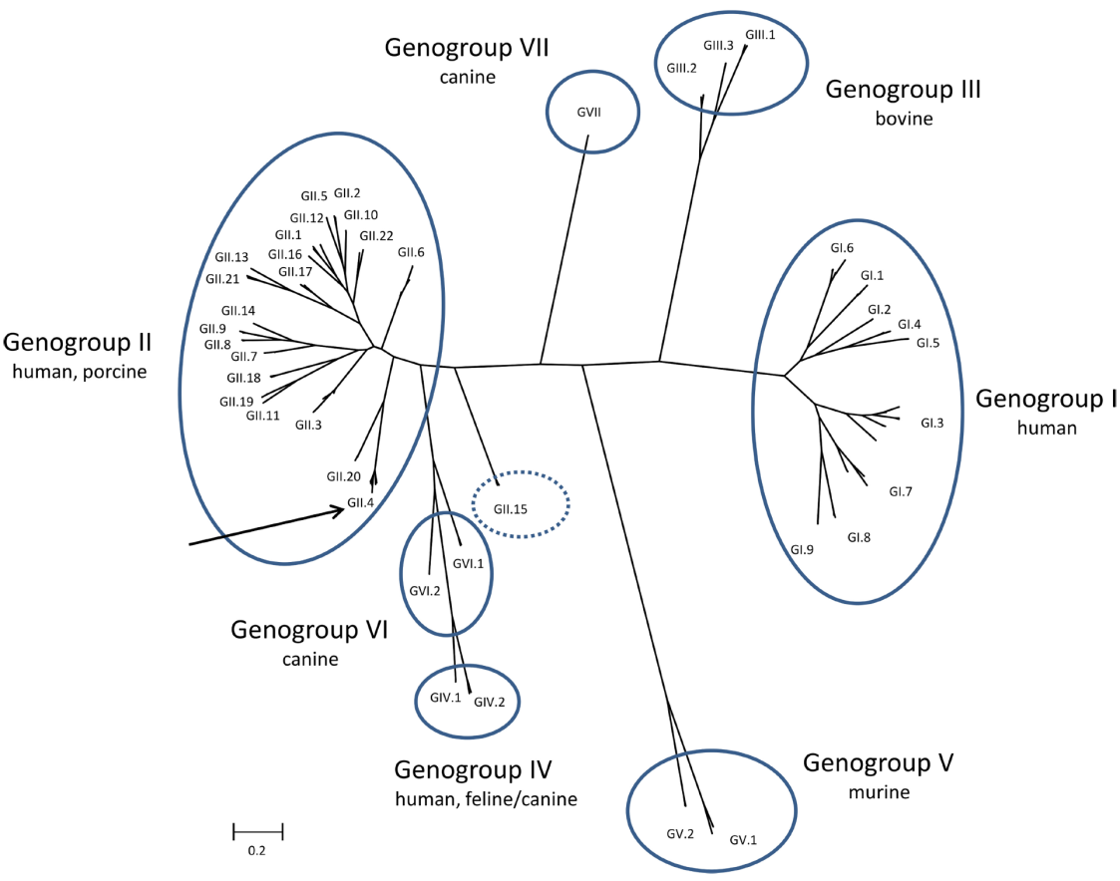
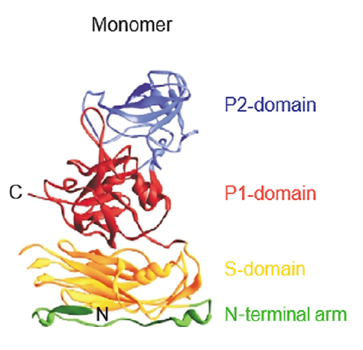
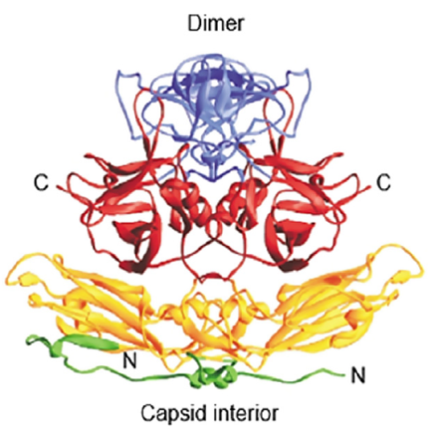
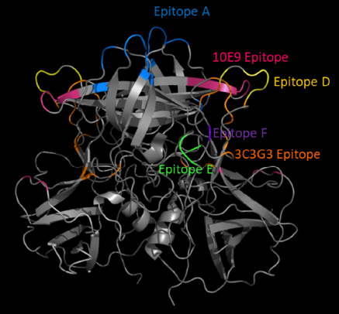
Norovirus: structural/functional properties
A non-enveloped icosahedral virus, ~40nm in size.
isoelectric point (iep) ≈ 4-4.5; surface wettability?
a single-stranded positive-sense RNA genome (7.5 kb )
Tarek et al. (2020)
Classification
based
on
VP1
amino
acid
sequence
Hutson et al. (2004)
Mallory et al. (2019)
Epitopes are involved in specific adhesions (HBGA affinity …)
Vinjé (2016)

Slide 9
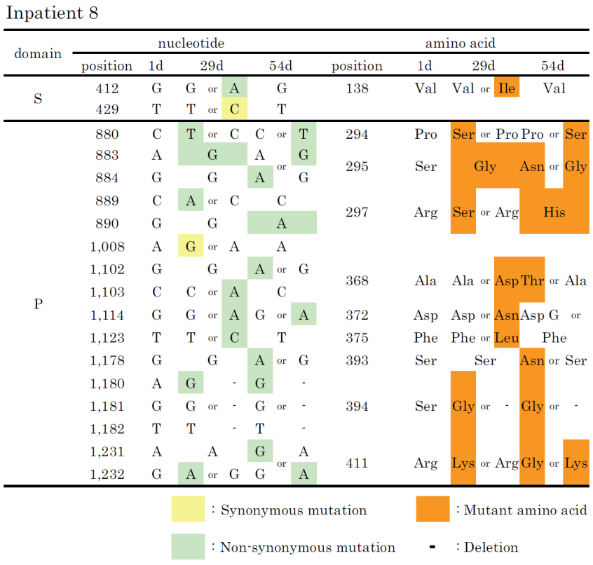
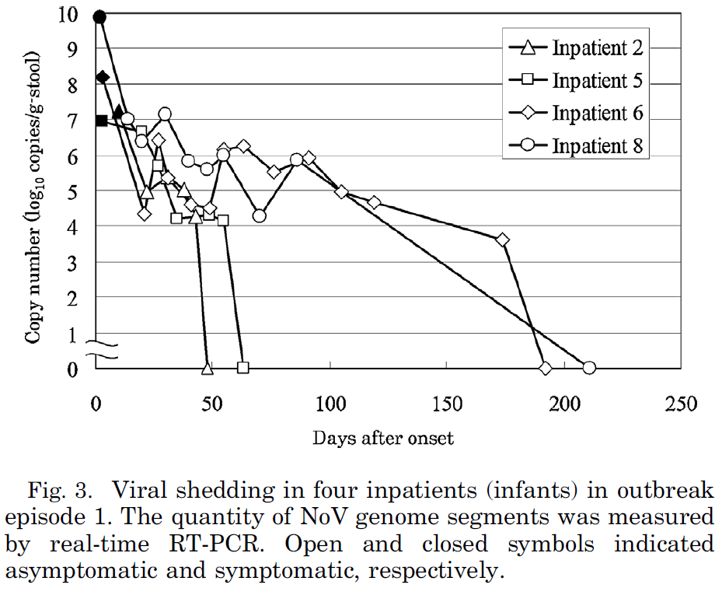
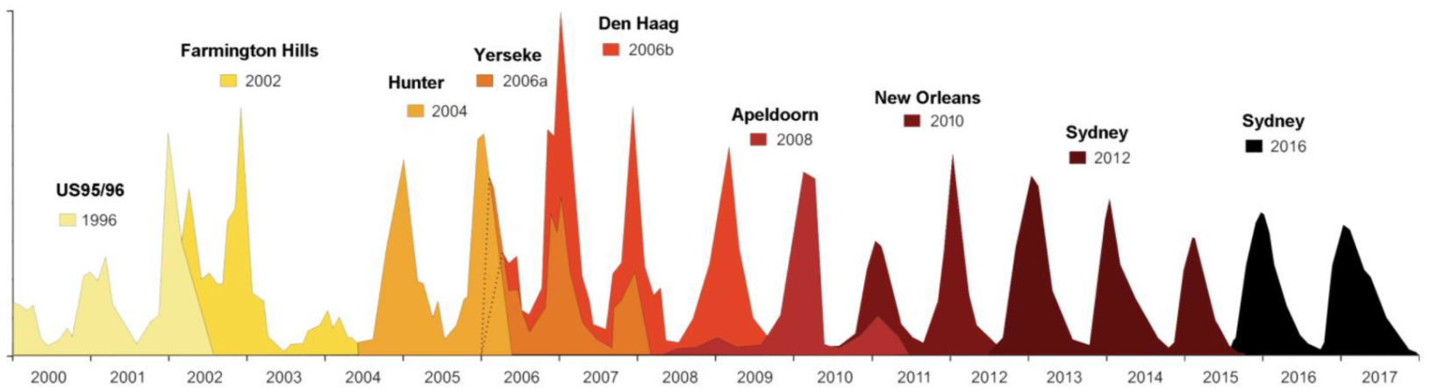
Norovirus: mutations affecting HBGA affinity
Mutations over a few weeks:
Impatient 8
Impatient 8
Miyoshi et al. (2015)
New pandemic strains every 2-3 years:
Contribute to epitope A
De Rougemont (2018)

Slide 10
Environmental fate of viruses after wastewater discharge

Slide 11
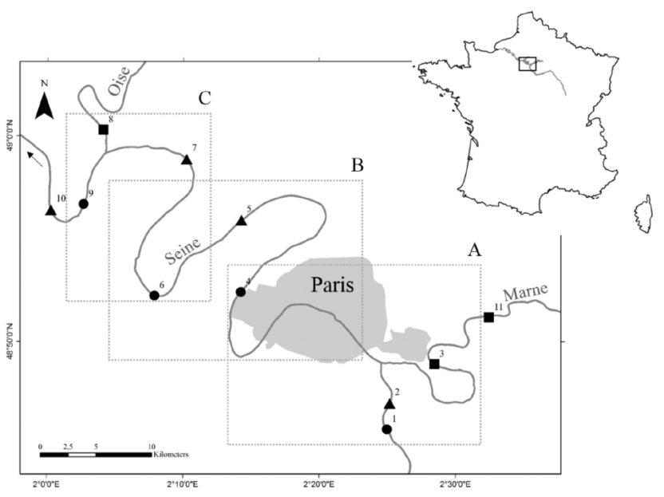
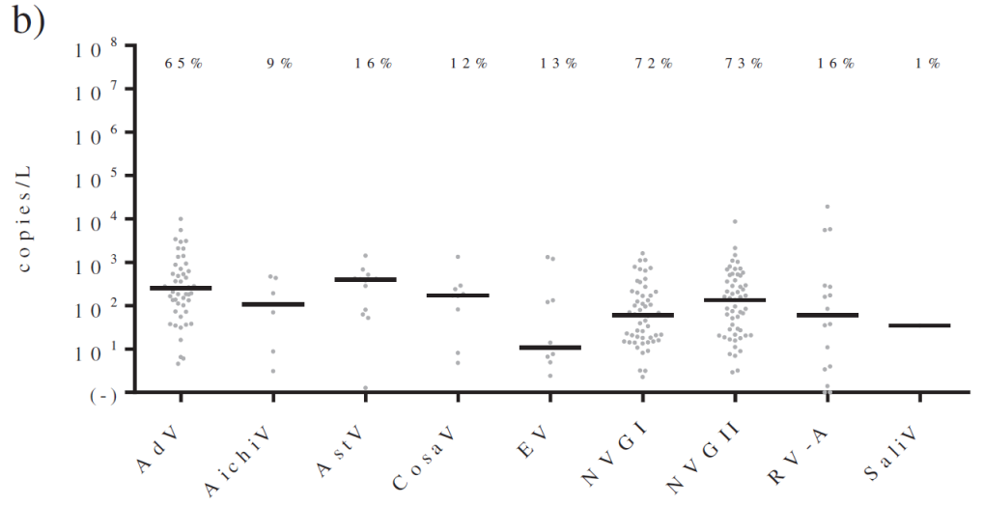
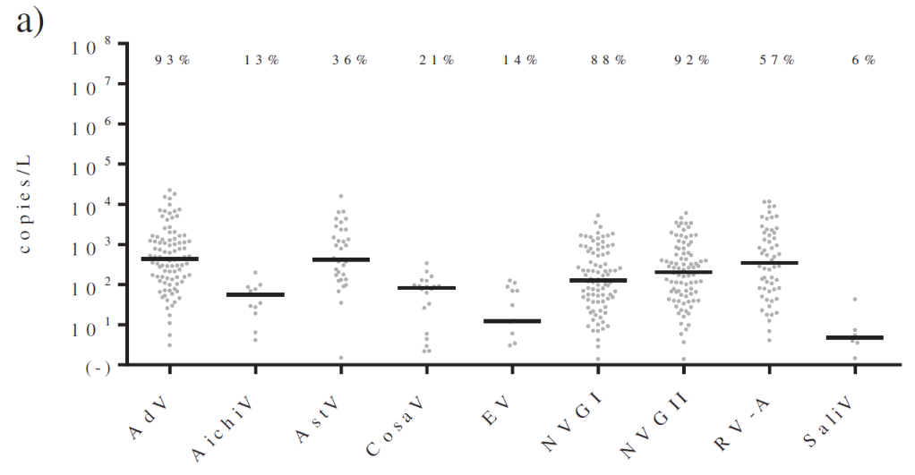
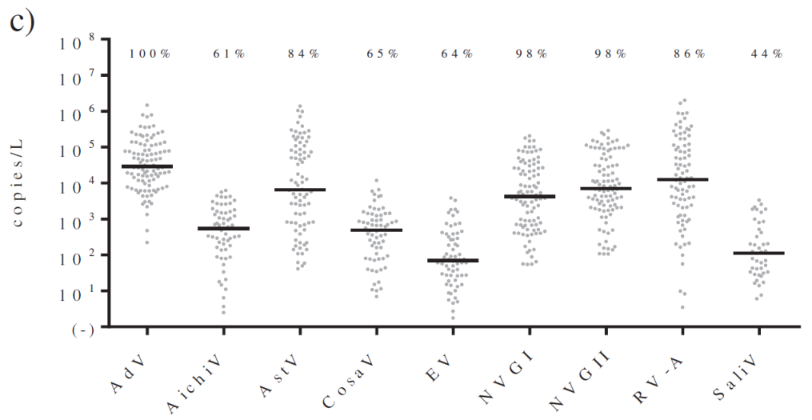
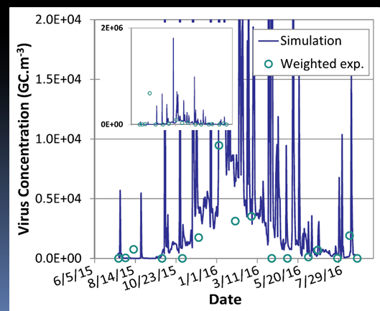
Contamination of rivers by wastewater discharge
Case of the Seine River near Paris
Prevost et al. (2015)
Contamination from the tributaries
Wastewater discharge after activated sludge
treatment
The resulting contamination of the Seine River
Medical prescriptions enable simulating the contamination of the Artière River
Tesson et al. (2019)

Slide 12
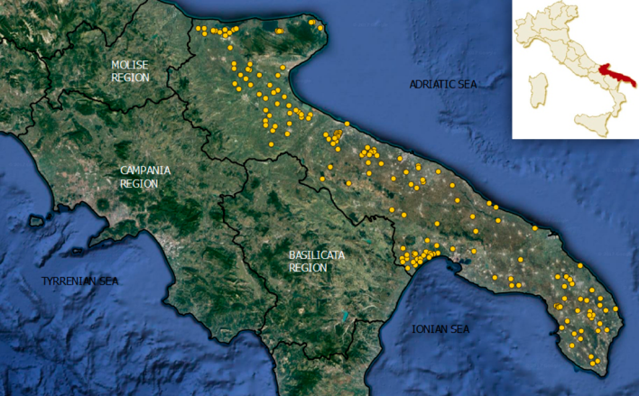
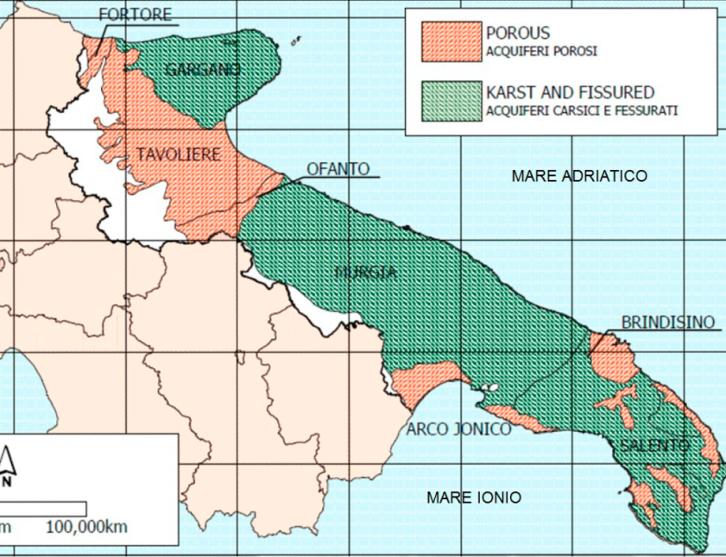
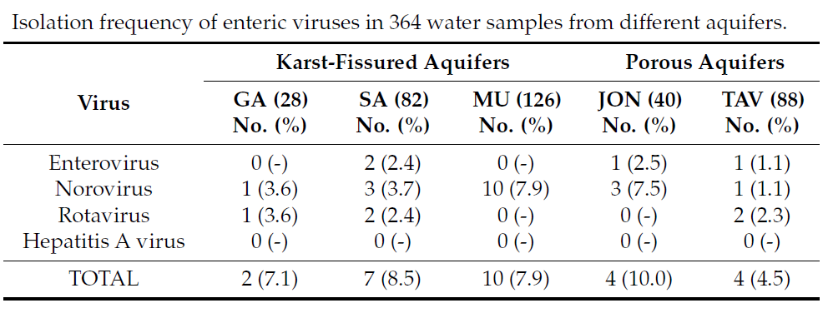
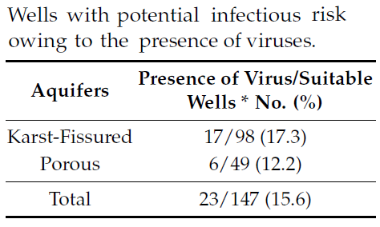
Underground water contaminations
Case of aquifers in Apulia (southern Italy)
Sampling in 3 karst-fissured aquifers
De Giglio et al. (2017)
Sampling in 2 porous aquifers

Slide 13
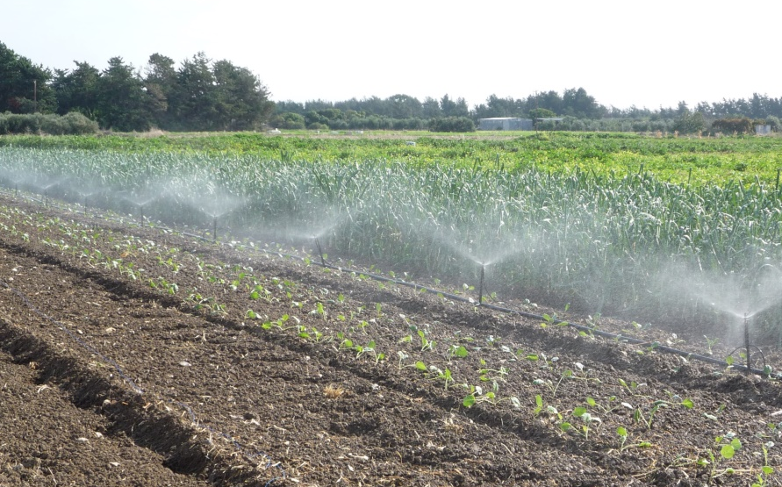
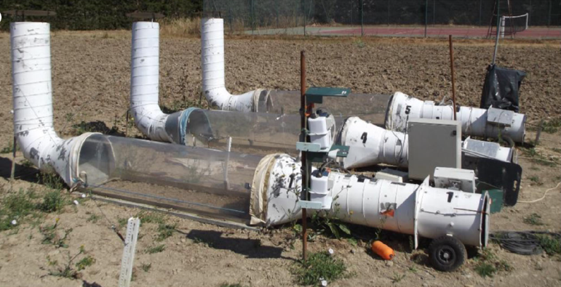
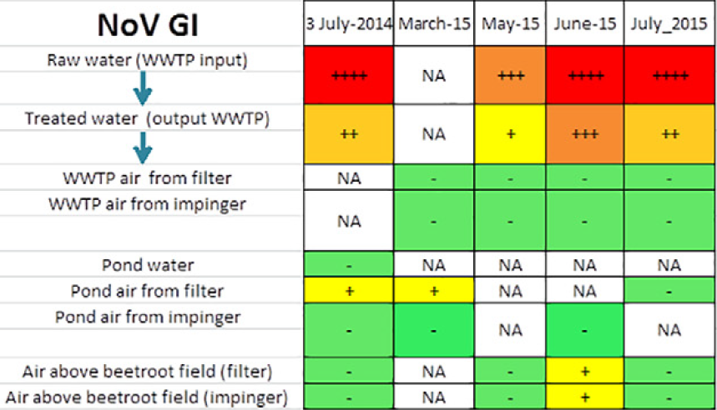
Environmental virus fate during/after irrigation
Virus as aerosol
Girardin et al. (2016)
Courault et al. (2017)
Contamination of external surfaces
of crops
Virus flow in the soil
with water infiltration
Virus internalization
in plants via their roots

Slide 14
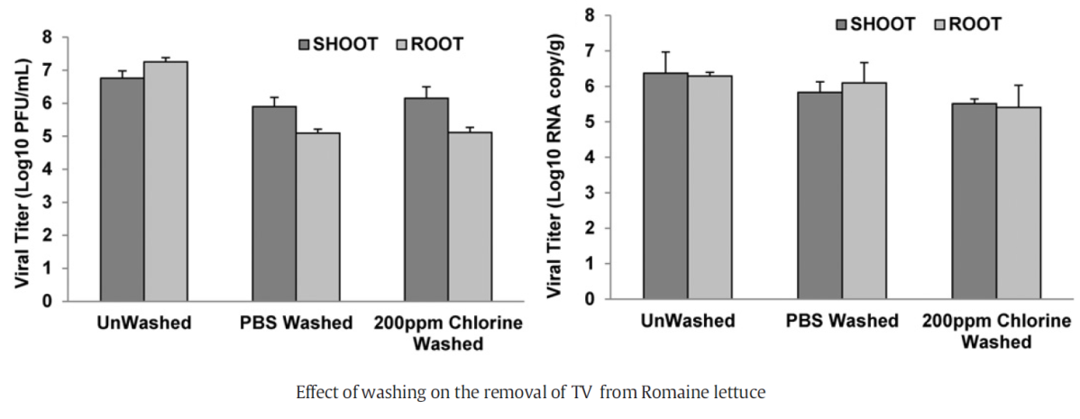
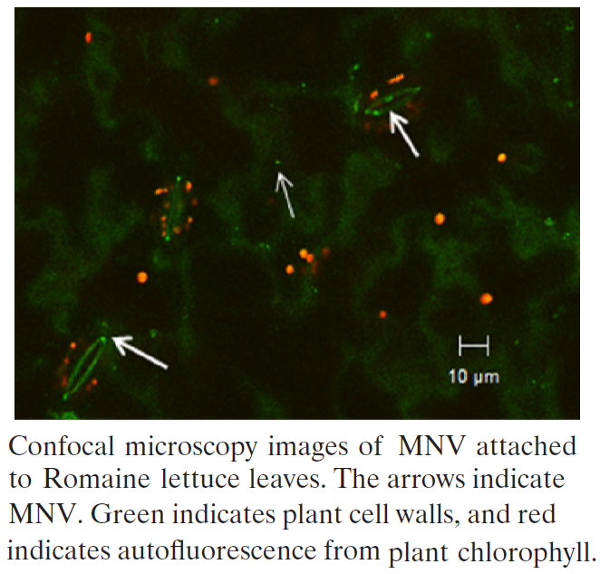
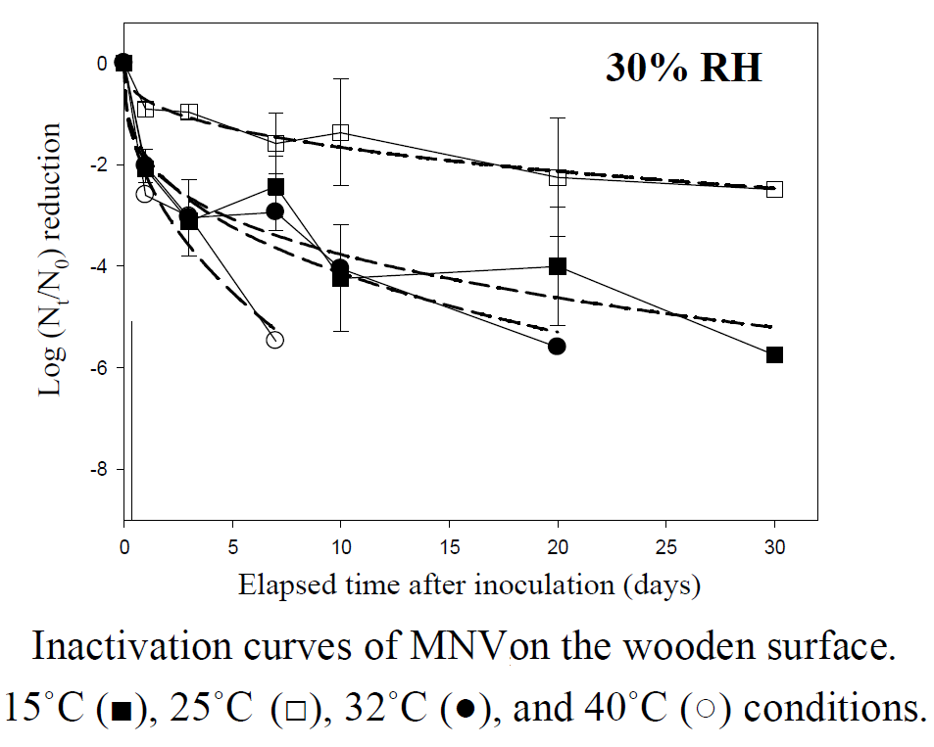
Attachment on external surface or plant materials
Murine NV (MNV-1) observed on lettuce surface, inside open cuts, and within stomata
Tulane virus (TV) attachment/washing vary with the virus, the plant organ and the liquid phase
TV plaque assay
TV by RT-qPCR
DiCaprio et al. (2015)
Wei et al. (2010)
MNV inactivation on inert surface varies with the surface type, and the air temperature and relative moisture
Kim et al. (2012)

Slide 15
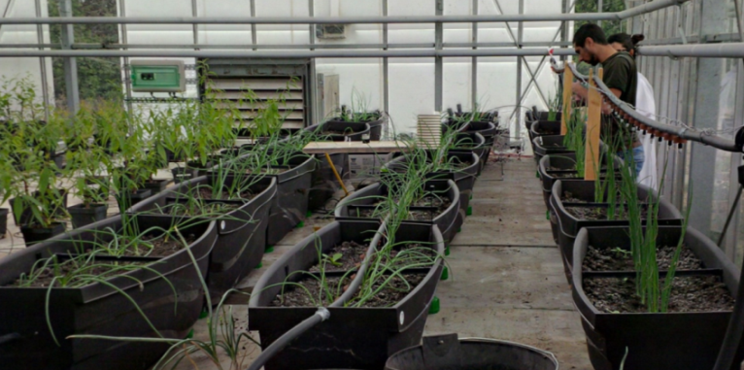
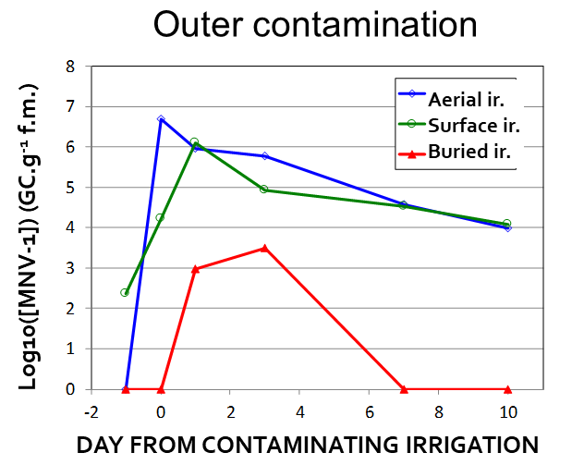
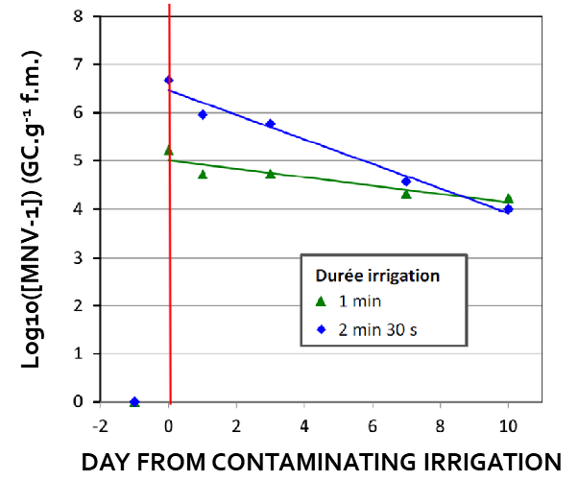
Irrigation/handling impact on outer contamination
Initial contamination + Decay (inactivation …) + Washing (rain …)
Green onion outer contamination varies with irrigation mode (buried, surface or aerial drip irrigation), as well as washing
But handling may explain most of vegetable and fruit contamination.
Pérez-Rodríguez (2019)
Washing proportional to the irrigation amount
Chards produced in La Ramada near Bogotá (Colombia) are contaminated by irrigation, “washing” and handling.
Duration of irrigation
1 min
2 min 30 s
Renault et al. (2017)
Jordan Lozano (2020)

Slide 16
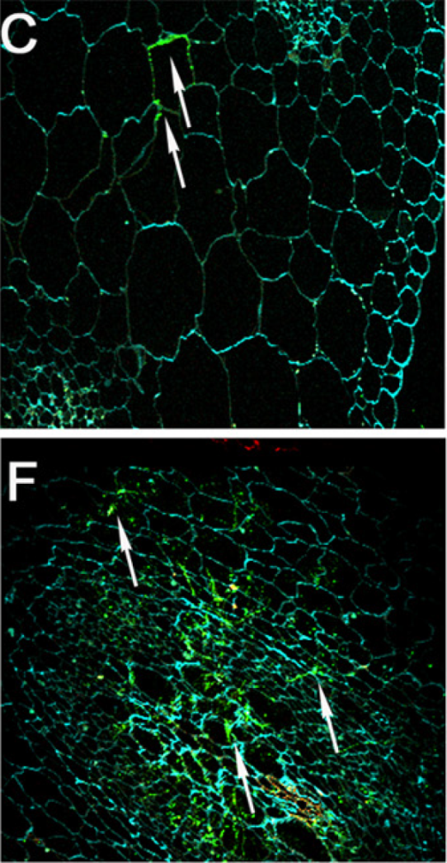
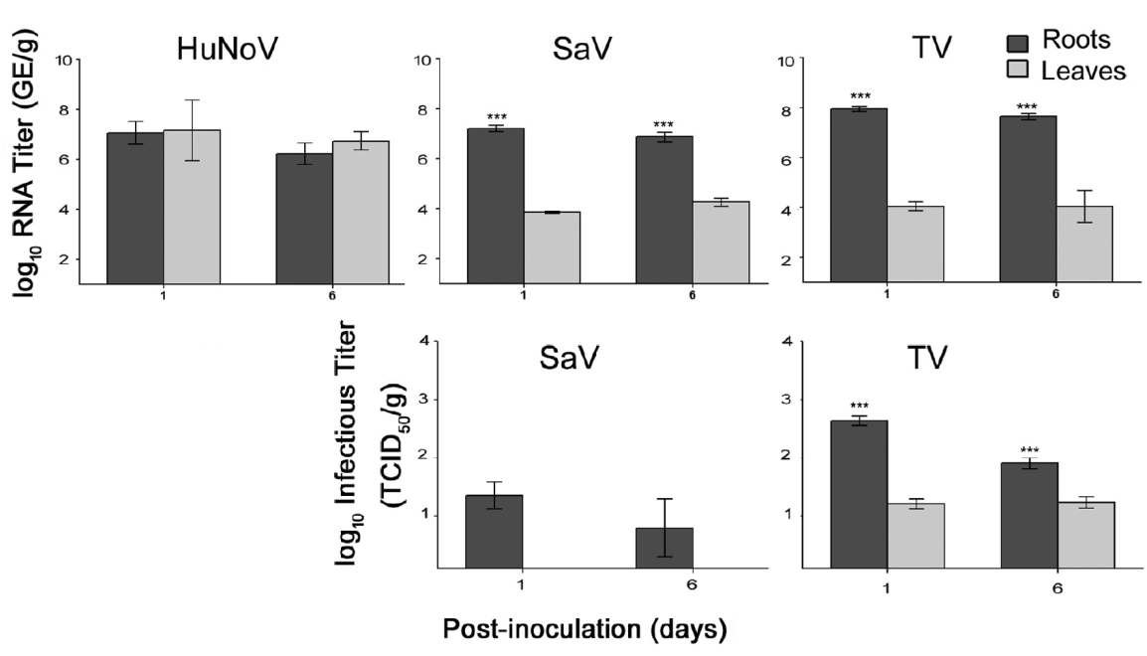
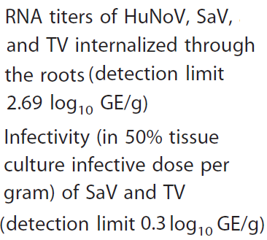
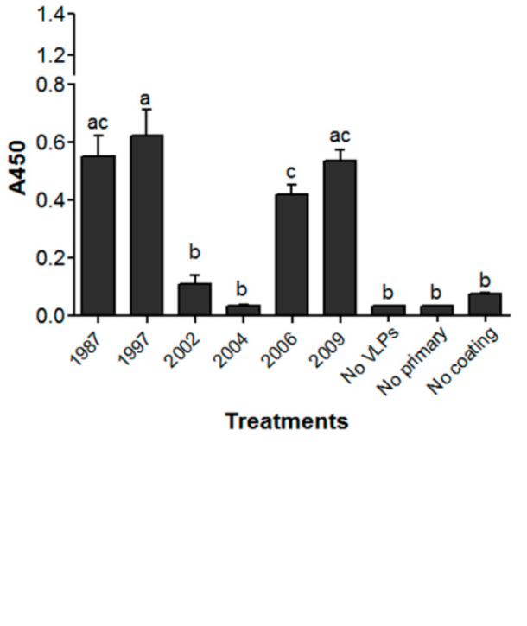
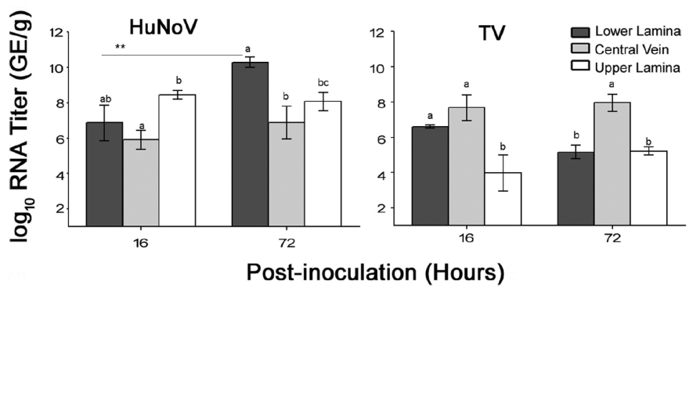
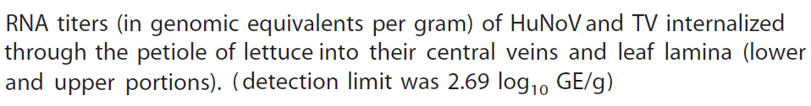
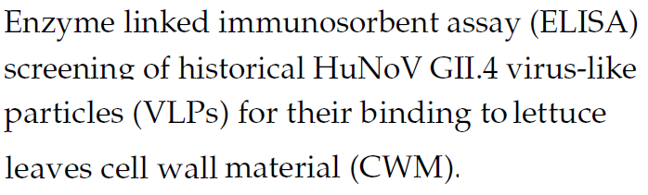
Virus internalization in vegetables and fruits
Internalization via the roots followed by migration without inactivation to parts eaten raw observed on lettuce, green onion, spinach and strawberry.
On whole lettuces after washing their root from soil and immersing them in a viral solution
Lettuce leaves
On cut leaves after immersing their base in a viral solution
The fate of viruses (migration, immobilization, inactivation) vary with virus and strain
Lettuce roots
Attachment
On cell wall materials
Esseili et al. (2018)
Esseili et al. (2019)

Slide 17
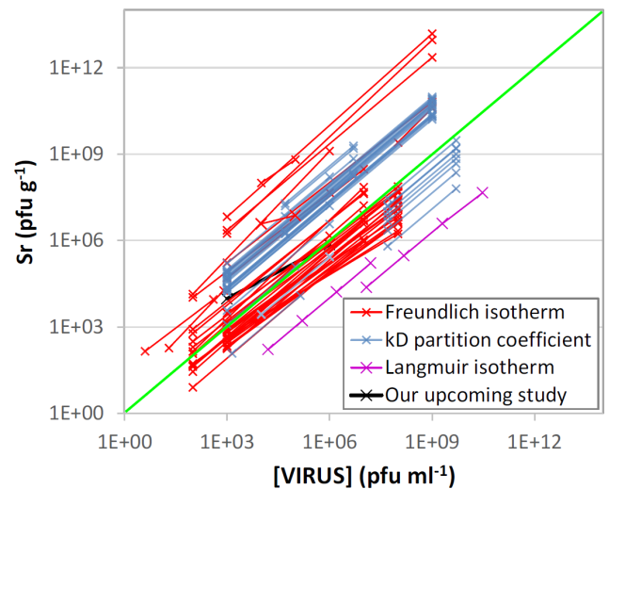
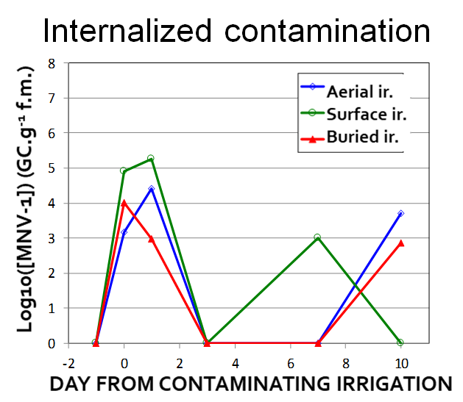
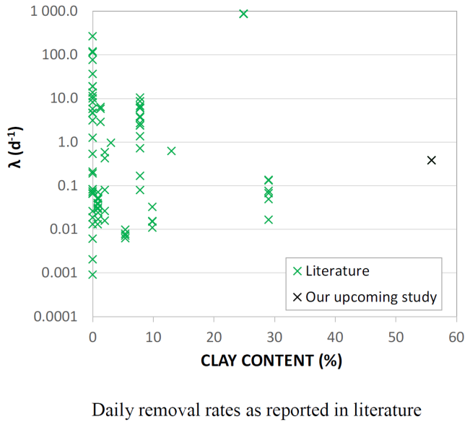
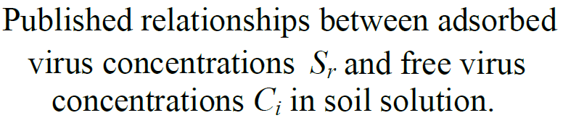
Irrigation mode and soil impact on internalization
Internalization of MNV-1 doesn’t vary with irrigation mode (aerial, surface, buried) as long as contaminated water reach absorbing roots of green onions
But the soil may affect the fate of viruses (immobilization, inactivation)
Tesson and Renault (2019)
Reversible immobilization
(from 25 papers)
Irreversible inactivation
(from 27 papers)
Renault et al. (2017)

Slide 18
Main topics to explore

Slide 19
They include:
Additional knowledge on the fate of human enteric viruses;
The development of systemic models to be combined with Quantitative Microbial Risk Assessment (QMRA)
The development of new methods and probes for scientific research as well as the monitoring in real times of contaminations.

Slide 20
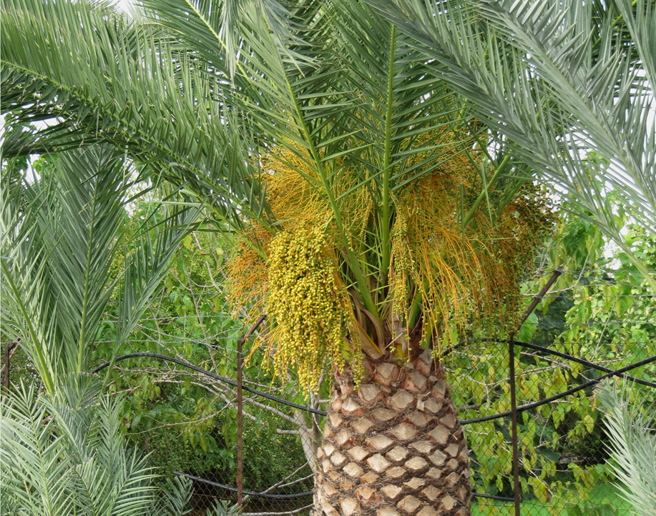
Thank you for your attention

