Slide 1
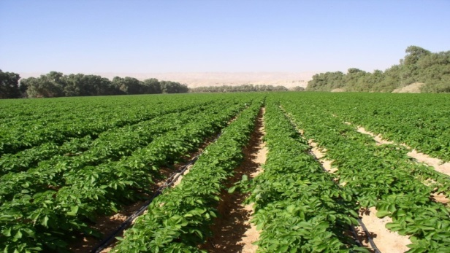
Potato Fertilization by Haifa
France-Israel Agronomy Symposium, Lille, November 27th – 28th , 2019
Gad Shahar, Chief agronomist & Knowledge manager, Haifa Group

Slide 2
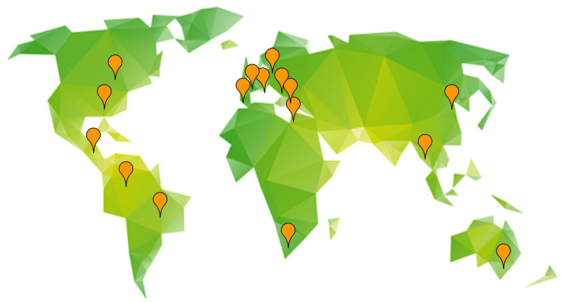
Haifa Group - Five decades of growth
Multinational corporation, founded in 1966
Owned by the Trump Group, an American
based Holding Company
Production of 330K tpa of Potassium Nitrate
Production plants located in Israel, France, USA, Canada
Logistic facilities – 3 worldwide terminals and 121 warehouses
Global presence - 16 subsidiaries worldwide

Slide 3


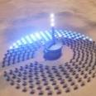

Haifa Group activity segments
Haifa Group is a leading global supplier of:
Potassium Nitrate
Specialty Plant Nutrients
Industrial Chemicals
Agriculture Specialty fertilizers for highly efficient agriculture | Industry Technical products for diverse industries | Solar Thermal Potassium Nitrate for Power Plants

Slide 4
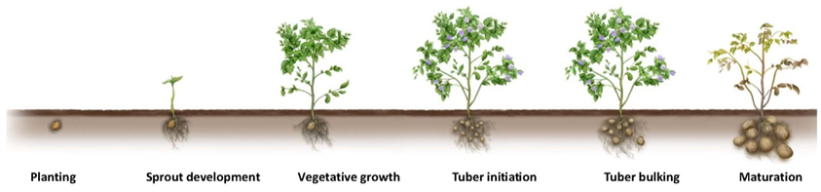

Haifa’s plant nutrition approach
High demand & supply
.
Controlled release fertilizer (pre planting) Haifa Multicote® agri + Nutrigation with Haifa WSF provide an optimal nutrition throughout the growth season.
Traditional fertilization practice: based on application of granular fertilizer (pre planting) induce hazardous excess to plant at the beginning followed by deficiency towards the end of the growth season.

Slide 5
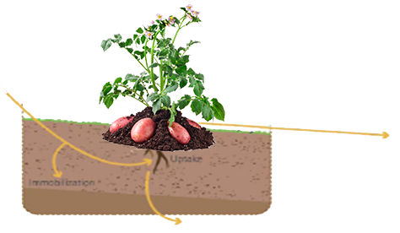
Losses & Contamination result from fertilization
NH₃ , N₂O, NO
Gaseous losses
Nutrients input
Runoff , erosion
Uptake
Immobilization
NO₃⁻
Leaching losses

Slide 6
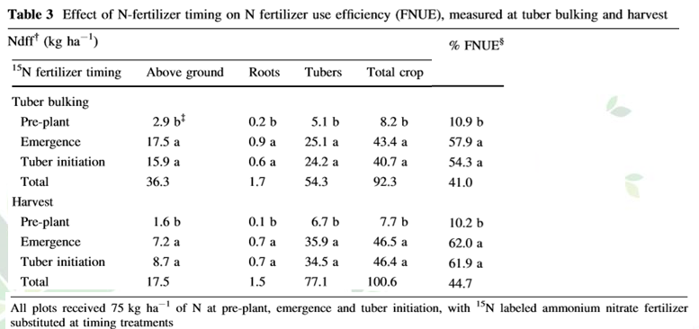
Nitrogen uptake efﬁciency in potato
Effect of N-fertilizer timing on N fertilizer use efﬁciency (FNUE)
Marketable yield 38 mt/ha , Atlantic - chipping potato varieties
Libby Rens . Lincoln Zotarelli . Ashok Alva . Diane Rowland . Guodong Liu . Kelly Morgan (2016)

Slide 7
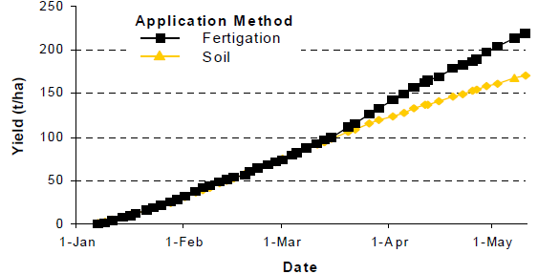
Nutrigation enhance nutrients availability at root zone
Applying nutrients in their soluble and thus available form to plant roots has an advantage, especially in the case of phosphorous and potassium.
These two elements are usually exposed to precipitation and adsorption processes in the soil, that reduce their availability to plants.
Repeated and often supply of these nutrients in irrigation water minimize these negative phenomena.
Accumulated cucumber yield as
affected by the method of
P application.

Slide 8
Nutrients Use Efﬁciency - NUE
Why? It is important to increase NUE
Environmental negative implications.
Increasing regulation on the nutrient applied quantity, mainly Nitrogen (N).
Nutrients deficient plant (mainly potassium) has lower WUE rate.
Loss of crops yield and quality.

Slide 9
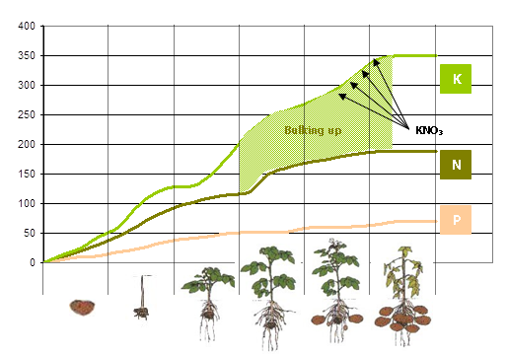
Potato nutrients uptake
Uptake (kg/ha) *
* Yield of 45 – 55 ton/ha

Slide 10
Haifa’s combined nutritional solutions
Nutritional programs may include a combination of products and application methods.
Granular NPK fertilizers
Controlled Release Fertilizer
Nutrigation™
Foliar nutrition
Through the pivot line, sprayer
or airplane
{ Soil applications
Water soluble based }
Before sowing
Throughout the season

Slide 11
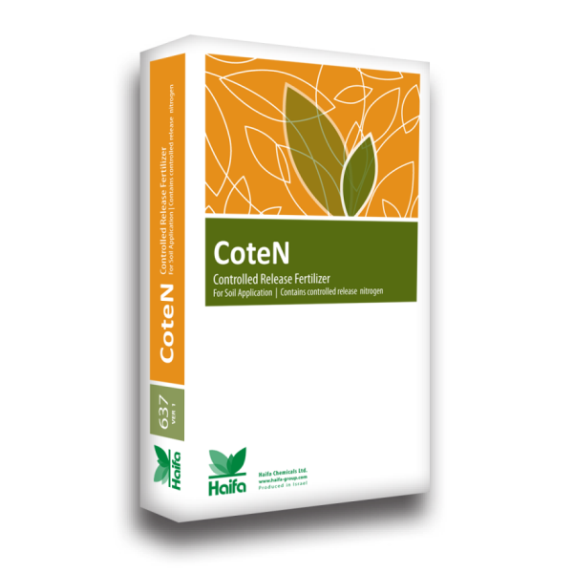
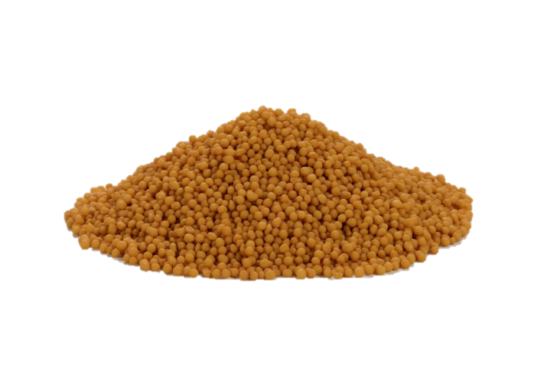
Fertilizers for base dressing: controlled release
Coated nutrients, based on Multicote™ technology
Provides continuous nutrition throughout the season
Recommended products
  CoteN™ - coated nitrogen, 2 or 4 months release
  Coated Turbo-K™ 14-14-17+2MgO+ME
Customized formulae are available

Slide 12
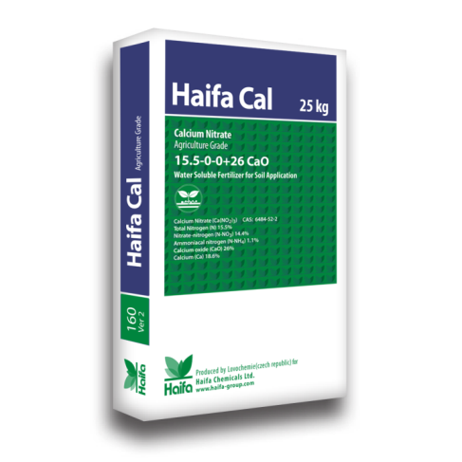
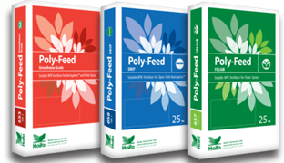
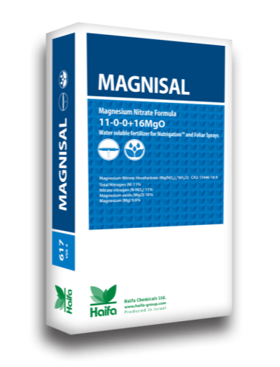
Soluble fertilizers for Nutrigation™
Optimal
plant nutrition
Pure
plant nutrients
Near zero sodium
and chloride
Environmentally
friendly

Slide 13
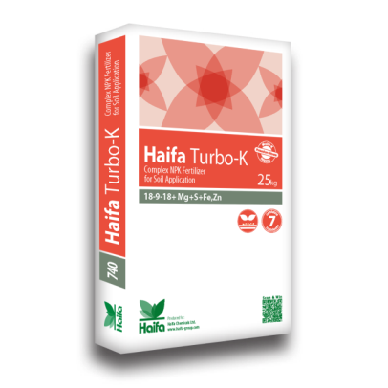
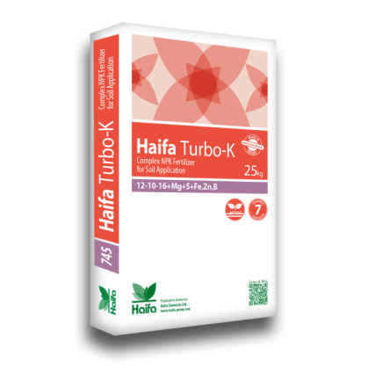
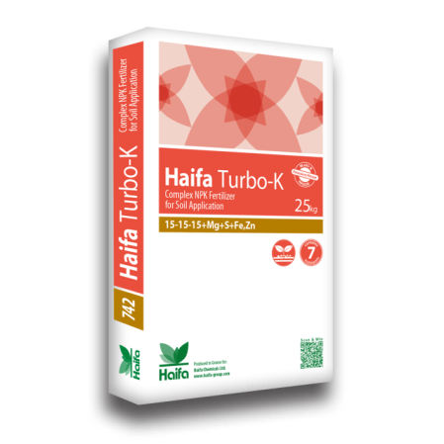
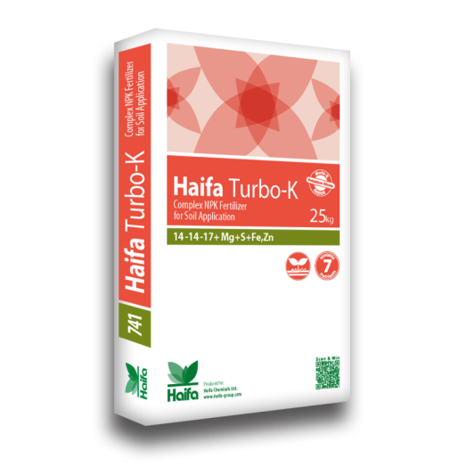
Fertilizers for base & top dressing: Haifa Turbo-K™
Granular fertilizers for soil application
Based on Haifa’s Multi-K™
Formulae contain N,P,K, Mg, S, Fe, Zn
18 – 8 – 9 + 2Mg0 +0.1Fe +0.02Zn

Slide 14
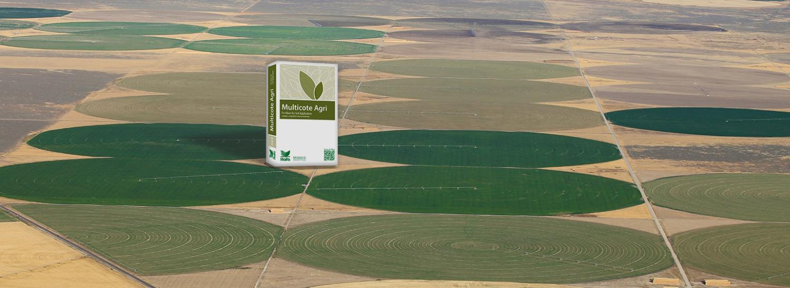
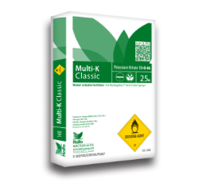
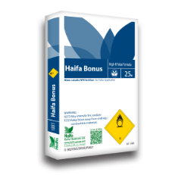
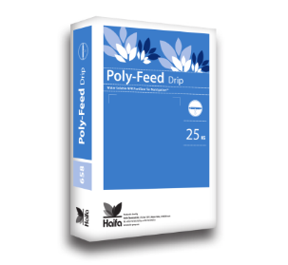
Haifa fertilization programs

Slide 15
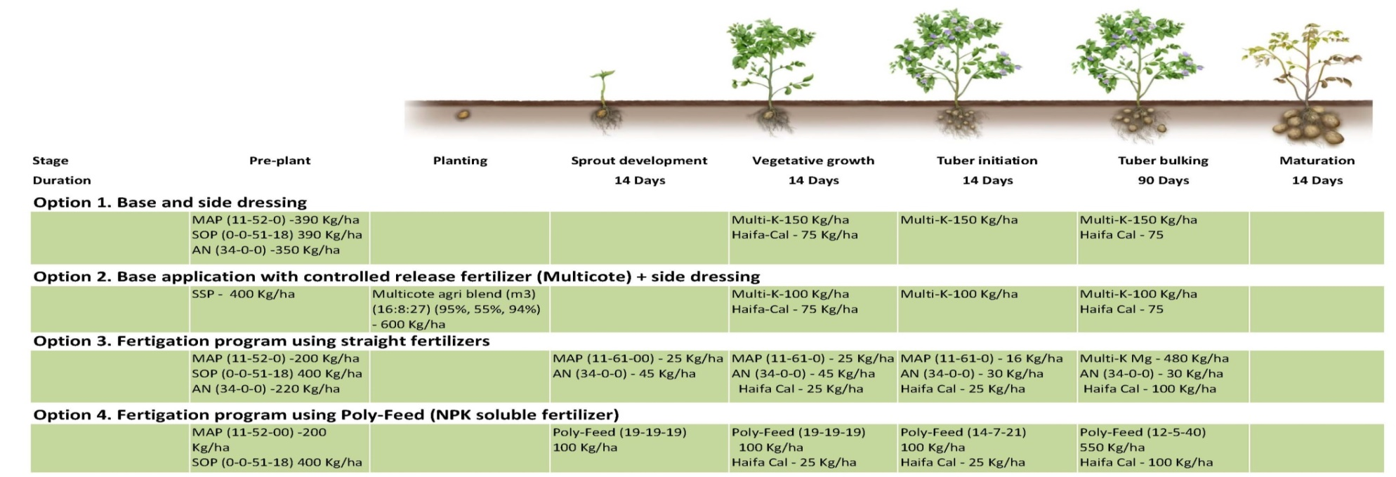
Suggested fertilization programs for Potato
Nutritional requirment (kg/ha): N=200-300 , P₂O₅=100-200 , K₂O=300-500
Expected yield: 45-55 T/Ha

Slide 16
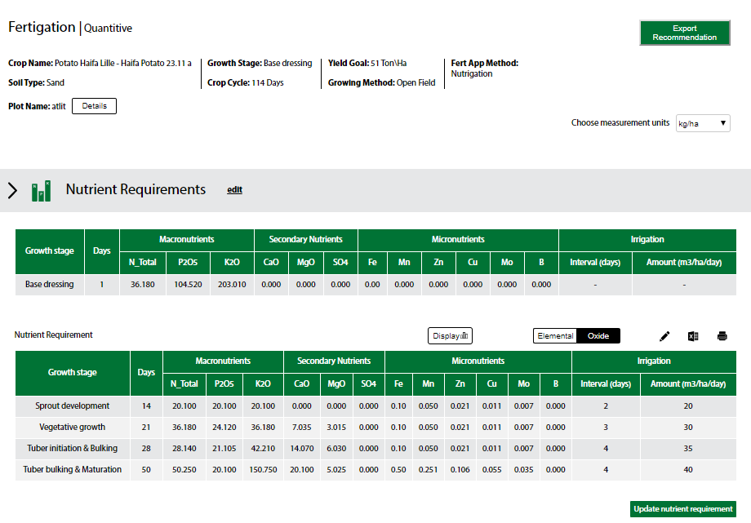
Haifa NutriNet ™ - Potato crop nutrients requirement

Slide 17
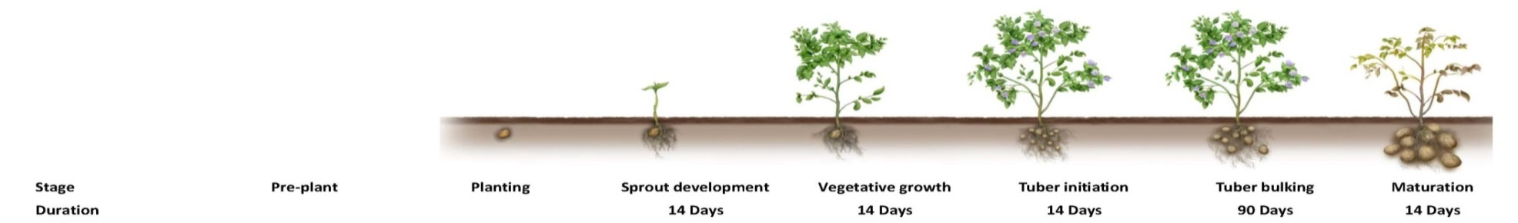
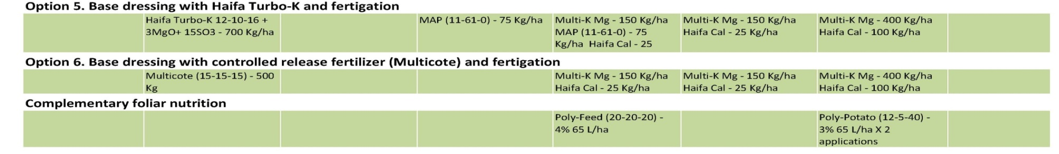
Suggested fertilization programs for Potato cont.

Slide 18
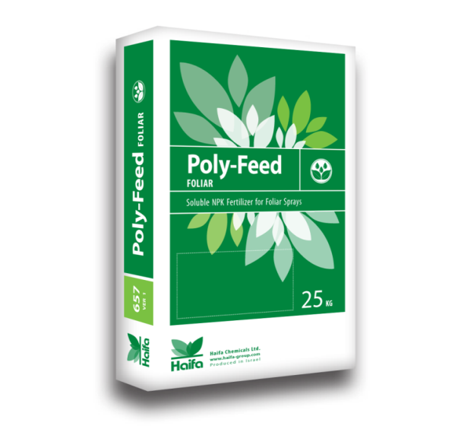

Boosting performance by Foliar Nutrition with Haifa Poly-Feed™
Stage | Poly-Feed™ Foliar analysis | Concentration | Spray volume
Vegetative growth | “Vegetative Booster” 21-21-21 | 2% - 5% | 50-80 L/ha
Tuber growth | “Poly-Potato” 12-5-40 | Two applications at 2%-4% | 50-80 L/ha

Slide 19

Haifa NutriNet ™
The Ultimate Service to customer (Knowledge sharing)
Haifa NutriNet™
Plant nutrition expert system
Rich and updated database about crops
and the Haifa solutions
Generating step-by-step Nutrigation™ program
Responsive to the dynamic changes
( climate, soil , water and more )
Cloud based. Manage, edit and store fertilization programs
The service is Free of Charge
Notes:
Rich and updated database about crops
and the Haifa solutions
Generating step-by-step Nutrigation™ program
Responsive to the dynamic changes
( climate, soil , water and more )
Cloud based. Easily Managing, edit and store fertilization programs, this will also enable us to integrate and sermonize into it an online crops growth and nutrition monitoring technologies.
The service is Free of Charge and soon will be available in 12 languages

Slide 20
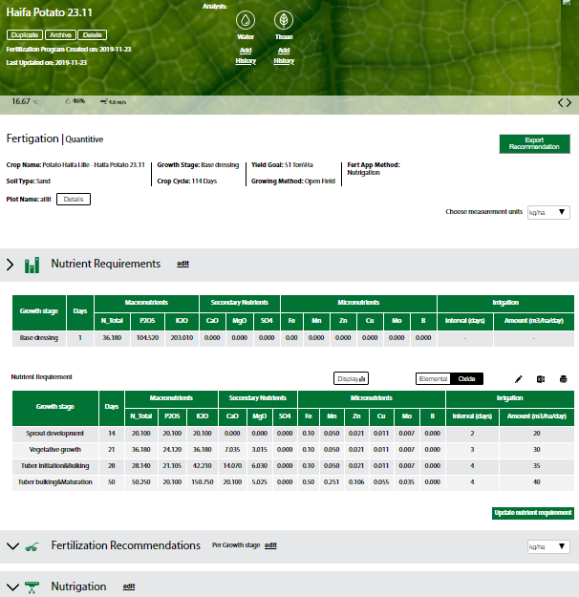
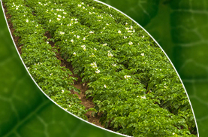
Haifa NutriNet ™- Program main page
Main features
Required nutrients per growth stage
Graphic/Table view
Elemental/Oxide view
Editing option for personal preferences
Export to XLS

Slide 21
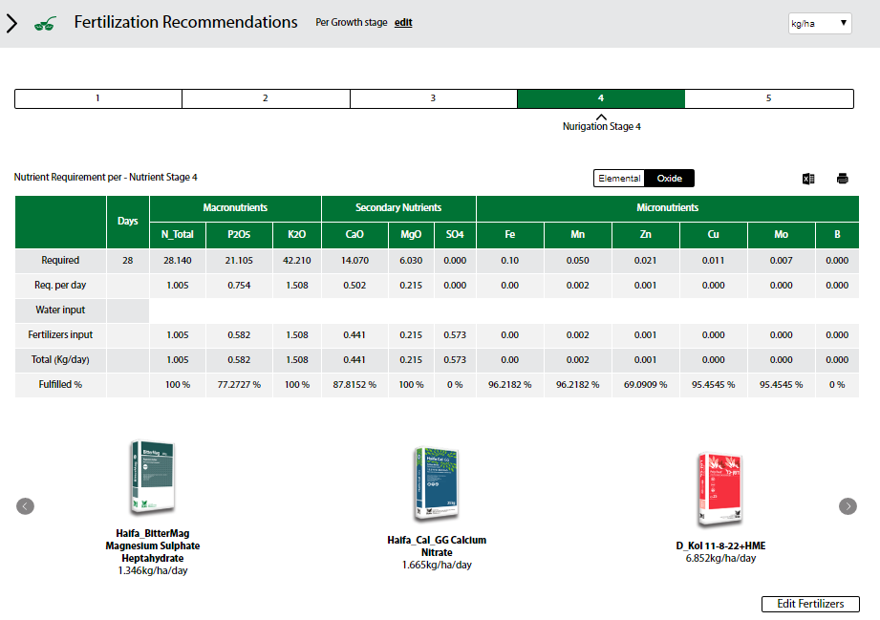
Haifa NutriNet ™ - Nutrients requirement

Slide 22
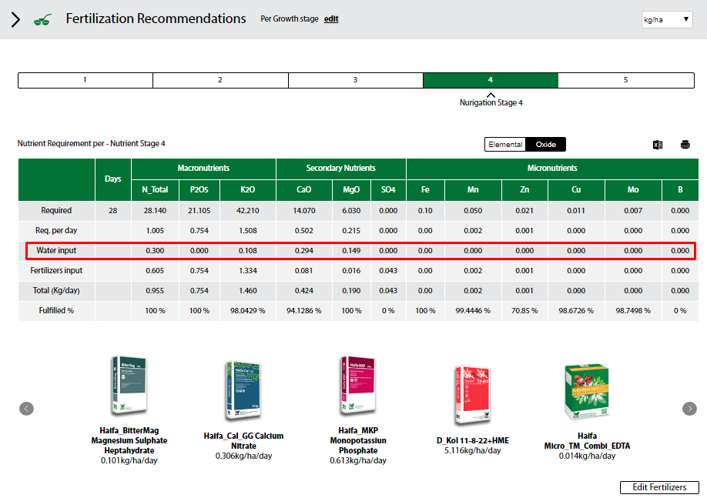
Haifa NutriNet ™ - Recommended fertilizers/products

Slide 23
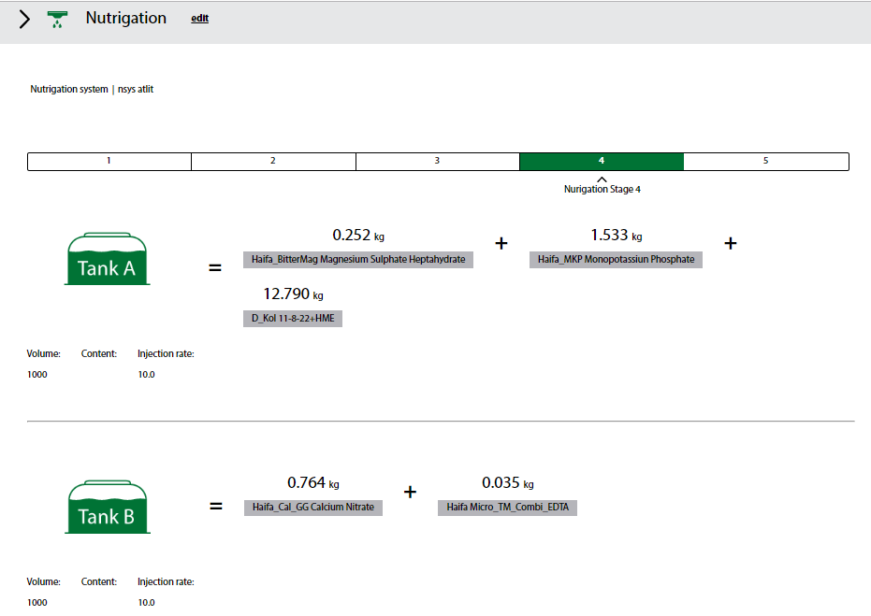
Haifa NutriNet ™ - Nutrigation practic

Slide 24
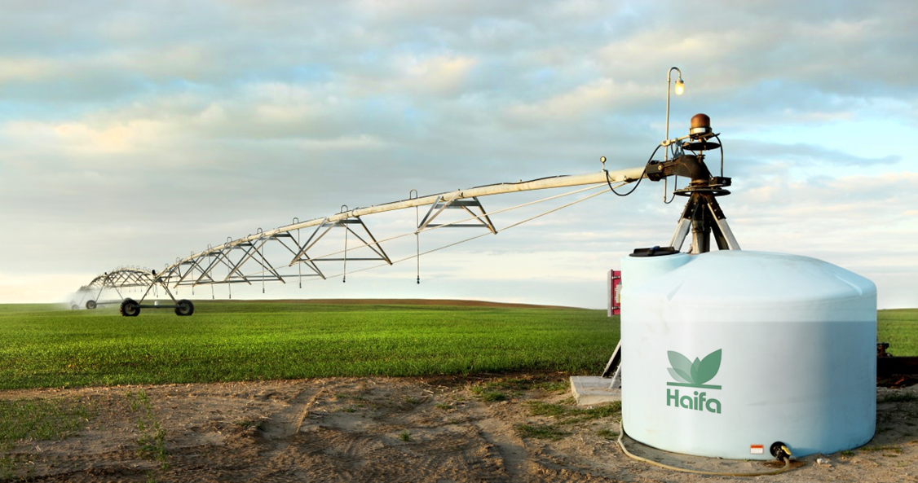
Proven results

Slide 25

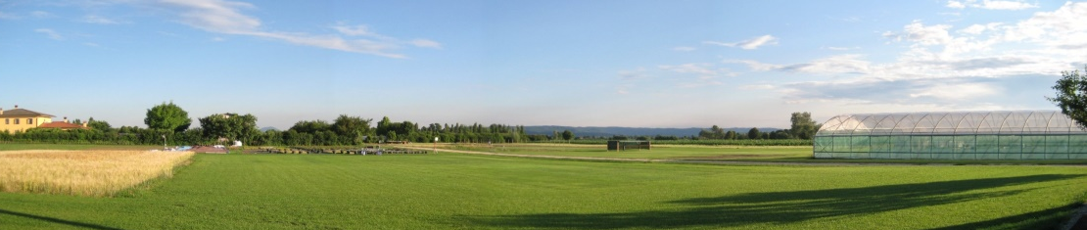
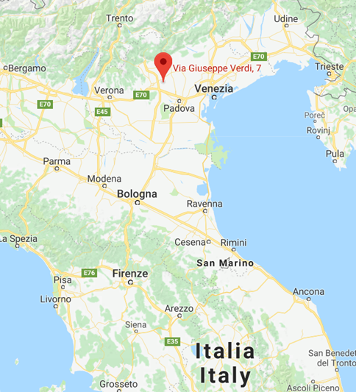
Haifa's Potato–Pivot trial – LandLab, 2018
Location: Italy
Season: Spring-Summer 2018
Variety : Potato (Var. Liliana) by Europlant
Soil: Medium (sandy-loam) soil, pH 7-7.5
Trial start: April 2018
Trial end: July 2018
Study Design: Randomized complete block
No. of entries = 5
No. of Replicates = 5 (4 for the entry 1)
No. of plots = 24
.

Slide 26
Treatments

Slide 27
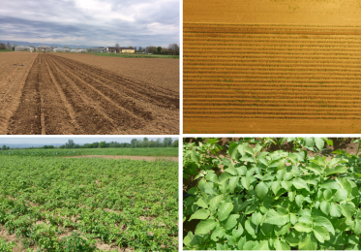
Yield results

Slide 28
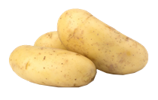
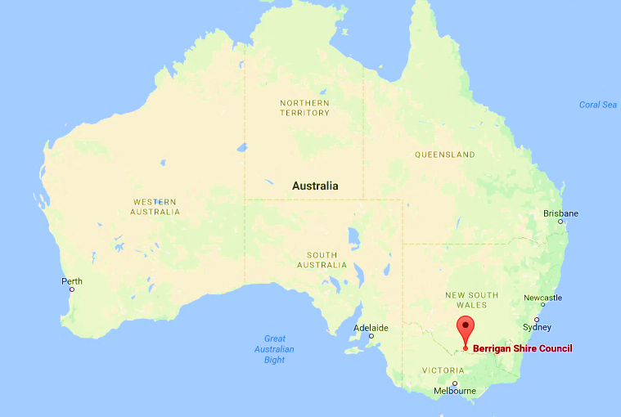
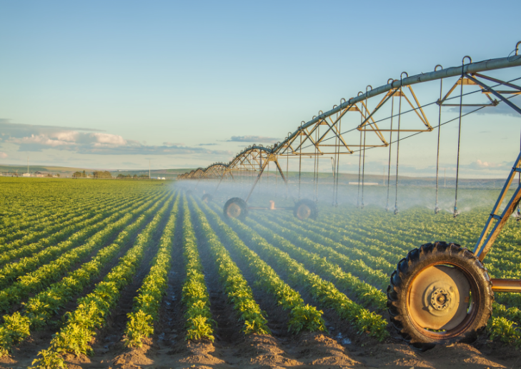
Potato trial in Australia
Variety: Russett Burbank (French fries)
Area: Berrigan, Southern New South Wales
Soil Type: Sandy, pH (water) 5.6

Slide 29
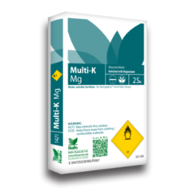
Potato trial in Australia - Treatments
.
Haifa treatment | Farmer’s practice
Base: 15-11-16+8SO_{3,} 1200 kg/ha | Base: 15-11-16+8SO_{3,} 1200 kg/ha At emergence: 19-0-14.4, 500 kg/ha | Soil fertilization
8 weekly applications of 25 kg/ha 12-0-42 + 2MgO + 25 kg/ha A.N. (34%N) starting at 3 weeks post emergence | 8 Weekly application of urea, total of 345 kg/ha | Nutrigation™
180 kg/ha N, 132 kg/ha P2O5, 192 kg/ha K₂O 92 kg/ha N, , 84 kg/ha K₂O 272 kg/ha N, 132 kg/ha P2O5, 276 kg/ha K2O | 275 kg/ha N, 132 kg/ha P2O5, 264 kg/ha K₂O 158 kg/ha N, 433 kg/ha N, 132 kg/ha P2O5, 264 kg/ha K2O | Base dressin Top dressing / Nutrigation
Total

Slide 30


Potato trial in Australia - Results
Tuber yield [ton/ha]
Cost & profit [US$/ha]
+50%
+62%
Haifa treatment
Farmer’s practice
Haifa treatment: higher yield and better value

Slide 31
Conclusions and topics for consideration
Irrigation and Fertilization (nutrigation) should be programmed and managed simultaneously.
Rationalizing both, quantity and timing wise maximizing potato yield and quality, and decreasing environmental negative impacts.
Future research / experiment design should be “multifactorial” evaluating mutual and reciprocal or influences.

Slide 32

Thank You
nutrinet.haifa-group.com

