Slide 2
Irrigation efficiency and optimization The Optirrig model
Bruno Cheviron, Claire Serra-Wittling, Juan-David Dominguez-Bohorquez, Magalie Delmas, Bruno Molle

Slide 3
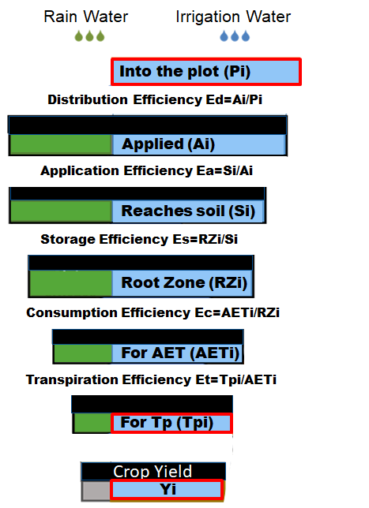
Water savings from improvements of... Irrigation efficiency
As defined in the "cascade scheme" of Serra-Wittling & Molle 2017
[Invited report for the French Ministry of Agriculture]
Color code
Fraction due to Irrigation Water
Fraction due to Rain Water

Slide 4
Water savings from improvements of... Irrigation efficiency
As defined in the "cascade scheme" of Serra-Wittling & Molle 2017
[Invited report for the French Ministry of Agriculture]
Color code
Fraction due to Irrigation Water
Fraction due to Rain Water
Rationale
Calculation of efficiencies and losses in 5 successive stages from irrigation water distribution to crop transpiration
Complete mixing of rain water (RW) and irrigation water (IW) in soil with time-variable volume fractions carried on through the "cascade scheme"
Challenge for metrology and modelling: quite tricky to code but physically sound and yields promising results

Slide 5
Water savings from improvements of... Irrigation efficiency
Leaks from
equipments
Stage 1
E=Ed=Ai/Pi
Applied
Brought in

Slide 6
Water savings from improvements of... Irrigation efficiency
Leaks from
equipments
Stage 2
Wind drift
E=Ed.Ea=Si/Pi
Reaches soil
Brought in

Slide 7
Water savings from improvements of... Irrigation efficiency
Leaks from
equipments
Stage 3
Wind drift
E=Ed.Ea.Es=Rzi/Pi
Runoff or
drainage
Stored in root zone
Brought in

Slide 8
Water savings from improvements of... Irrigation efficiency
Leaks from
equipments
Stage 4
Wind drift
E=Ed.Ea.Es.Ec=AETi/Pi
Runoff or
drainage
Evapotranspirated
Brought in
Weeds or
excessive storage

Slide 9
Water savings from improvements of... Irrigation efficiency
Leaks from
equipments
Stage 5
Wind drift
E=Ed.Ea.Es.Ec.Et=Tpi/Pi
Runoff or
drainage
Finally transpirated
Brought in
Weeds or
excessive storage
Evaporation

Slide 10
Water savings from improvements of... Irrigation efficiency
Leaks from
equipments
Stage 5
Wind drift
E=Ed.Ea.Es.Ec.Et=Tpi/Pi
Runoff or
drainage
E=[0,1] x ... x [0,1]∈ [0,1]
Examples
E=0.90⁵ = 0.69
E=0.75⁵ = 0.24
Weeds or
excessive storage
Real-life realistic range
Evaporation
Quite drastic effect, nope?

Slide 11
Water savings from improvements of... Irrigation efficiency
Leaks from
equipments
Stage 5
Wind drift
E=Ed.Ea.Es.Ec.Et=Tpi/Pi
Runoff or
drainage
Efficiency E=Tpi/Pi mm/mm or [-]
Productivity P=Yi/Pi (ton/ha)/mm
Profitability F=Fi(Yi)/Pi (€/ha)/mm
Weeds or
excessive storage
"Then I should definitely increase my irrigation water efficiency"
Evaporation

Slide 12
Water savings from improvements of... Irrigation efficiency
Leaks from
equipments
Stage 5
Wind drift
E=Ed.Ea.Es.Ec.Et=Tpi/Pi
Runoff or
drainage
Efficiency E=Tpi/Pi mm/mm or [-]
Productivity P=Yi/Pi (ton/ha)/mm
Profitability F=Fi(Yi)/Pi (€/ha)/mm
Weeds or
excessive storage
"Then I should definitely increase my irrigation water efficiency"
Evaporation
"Yes buddy and you should really
start by reducing the losses"

Slide 13
Water savings from improvements of... Irrigation efficiency
Leaks from
equipments
Technical losses
Various upstream losses
Improper, defective or miscontrolled plot equipment
Wind drift
Runoff or
drainage
Tactical losses
Dummy, default or too constrained irrigation strategy
Weeds or
excessive storage
"Then I should definitely increase my irrigation water efficiency"
Evaporation
"Yes buddy and you should really
start by reducing the losses"

Slide 14
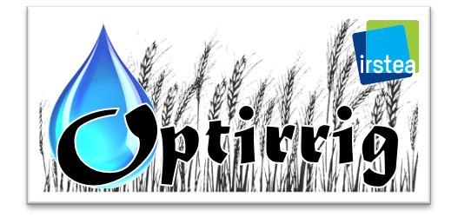
Water savings from improvements of... Irrigation efficiency
Leaks from
equipments
Generation, analysis & optimization
of crop irrigation scenarios
Wind drift
Dedicated module that handles irrigation water efficiency
v1.7R
Runoff or
drainage
Tactical improvements vs. Tactical losses
Improving irrigation strategy by tuning irrigation scenarios
Weeds or
excessive storage
"Then I should definitely increase my irrigation water efficiency"
Evaporation
"Yes buddy and you should really
start by reducing the losses"

Slide 15
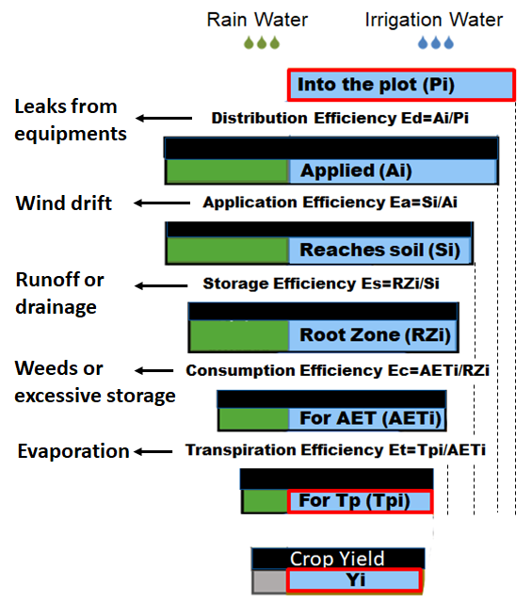
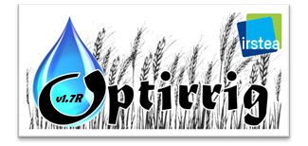
Water savings from improvements of... Irrigation efficiency
Efficiency module
Output example 1
Total soil profile reserve from sowing to harvest (mm)
"Ahem these irrigations took place just before rain events"
Original legend in French
To show the initial conditions

Slide 16
Water savings from improvements of... Irrigation efficiency
Efficiency module
Output example 2
Cumulative deep drainage from sowing to harvest (mm)
"Ok there was drainage of irrigation water here"
Drainage of irrigation water (mm)
Drainage of rain water (mm)
Irrigation (mm)
Rain (mm)

Slide 17
Water savings from improvements of... Irrigation efficiency
Efficiency module
Output example 3
Cumulative soil evaporation from sowing to harvest (mm)
"Some of it is evaporated, some of it expectedly transpirated, huh?"
Evaporation of irrigation water (mm)
Evaporation of rain water (mm)
Irrigation (mm)
Rain (mm)

Slide 18
Water savings from improvements of... Irrigation efficiency
Efficiency module
Output example 4
Cumulative crop transpiration from sowing to harvest (mm)
"Seems good as more transpiration than evaporation occurs AND the pale blue fraction increases with time "
Transpiration of irrigation water (mm)
Transpiration of rain water (mm)
Irrigation (mm)
Rain (mm)

Slide 19
Water savings from improvements of... Irrigation efficiency
Efficiency module
Output example 4
Summary of the key terms in the efficiency cascade scheme
"Ouch my upstream losses hurt and irrigation storage is so damn high!"
Upstream losses (mm)
Drainage (mm)
Storage of irrigation water in soil (mm)
Evaporation of irrigation water (mm)
Transpiration of irrigation water (mm)
Global efficiency (-)
Irrigation (mm)
Rain (mm)
Global efficiency Tpi/Pi

Slide 20
Water savings from improvements of... Irrigation efficiency
"I need to evaluate or reformulate my irrigation strategies, especially in a context of limited resource availability"
" is here for you, and can be tuned to save water by improving irrigation efficiency... but instead of an autograph I made a little drawing for you"

Slide 21
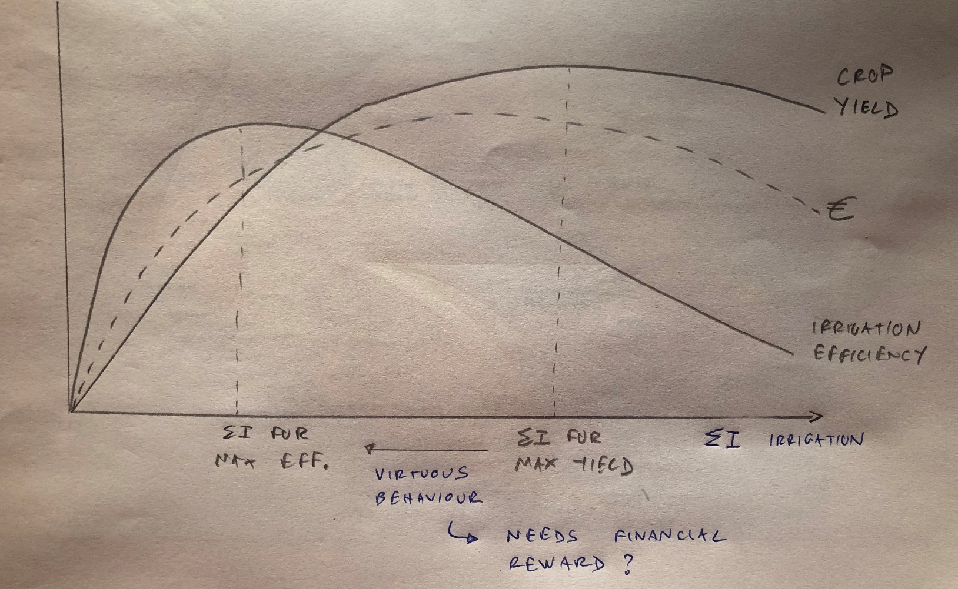
Water savings from improvements of... Irrigation efficiency
"Think about it:
1- Maximum crop yield is obtained for higher irrigation amounts than these of maximum irrigation efficiency
2- Reducing irrigation to improve efficiency is a virtous behavious that may need/deserve a financial reward"

