Slide 1

Reduction of food losses by retail packaging
REGION SUD – ISRAEL WEBINAR
November 29, 2021
Dr. Ron Porat
Dept. of Postharvest Science
ARO, The Volcani Institute, Israel

Slide 2
Contents:
1. Short background on FLW.
2. Effects of retail packaging on F&V quality.
3. The current situation in Israel.

Slide 3
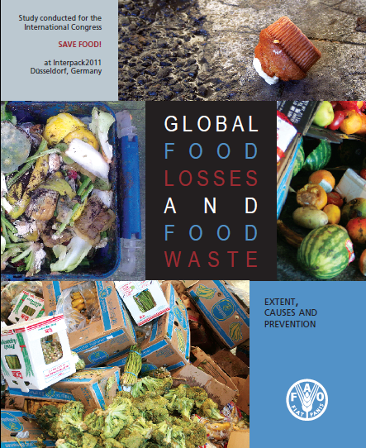
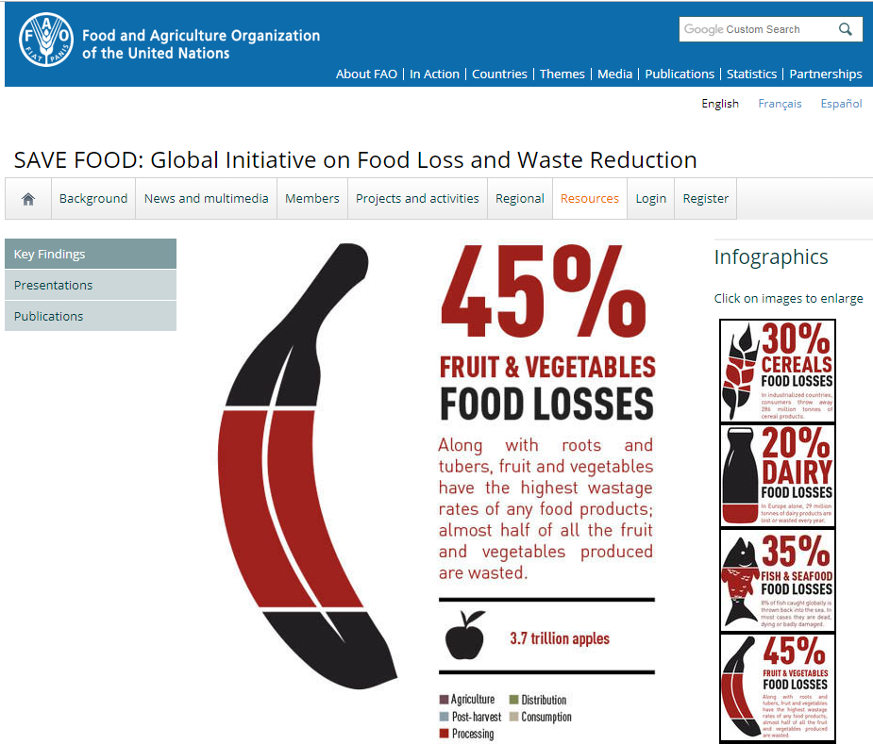
Food loss and waste
Studies by the FAO demonstrated that a third of all food and 45% of F&V are wasted.
“F&V have the highest wastage rates of any food products”!

Slide 4

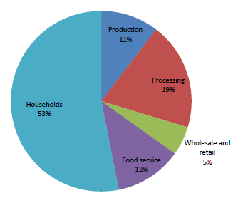
Most food losses in the EU occur at households
EU FUSIONS Report, 2016

Slide 5
Reduction of food losses by retail packaging
A key factor that may assist in maintaining F&V quality after harvest is using MA/MH PACKAGING!

Slide 6

“Packaging is promoted to reduce 10-15% food looses during retail and 20-25% of food waste at households”
AMERIPEN, Jan. 2018

Slide 7
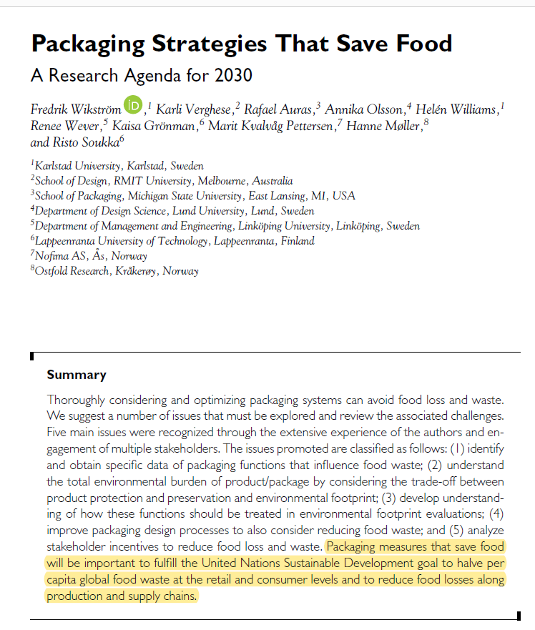
Journal of Industrial Ecology , 21.4.2018
‘Packaging Saves Food Research Group’
“Optimizing packaging can avoid food loss and waste”
“Packaging measures are important to fulfil the UN SDG goal to halve per capita food waste”

Slide 8
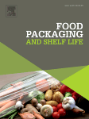
Advantages of F&V packaging
• Protection from physical damage
• Improve food safety
• Modified humidity reduces water loss and shrinkage
• Modified gas atmosphere reduces ripening and senescence
• Printing information (Country, quality grade)
• Economical benefits for on-line marketing

Slide 9
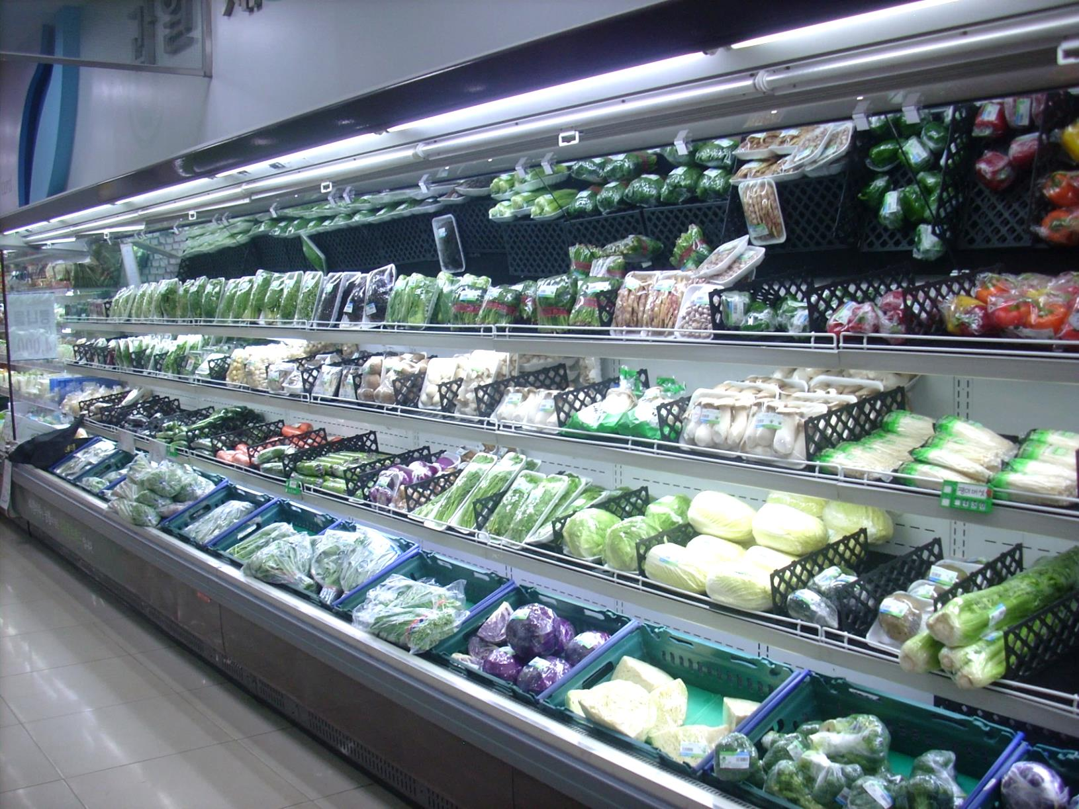
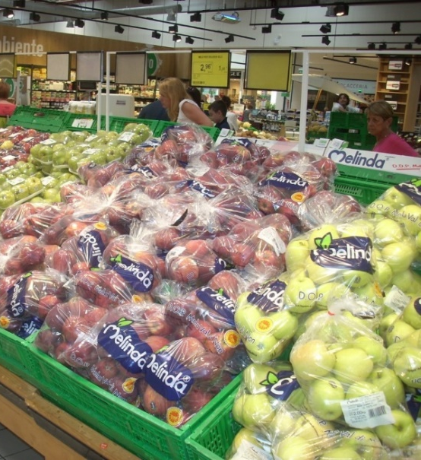
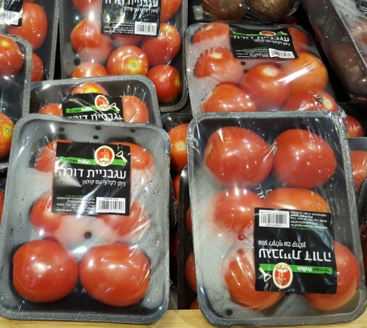
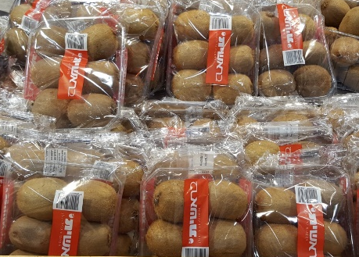
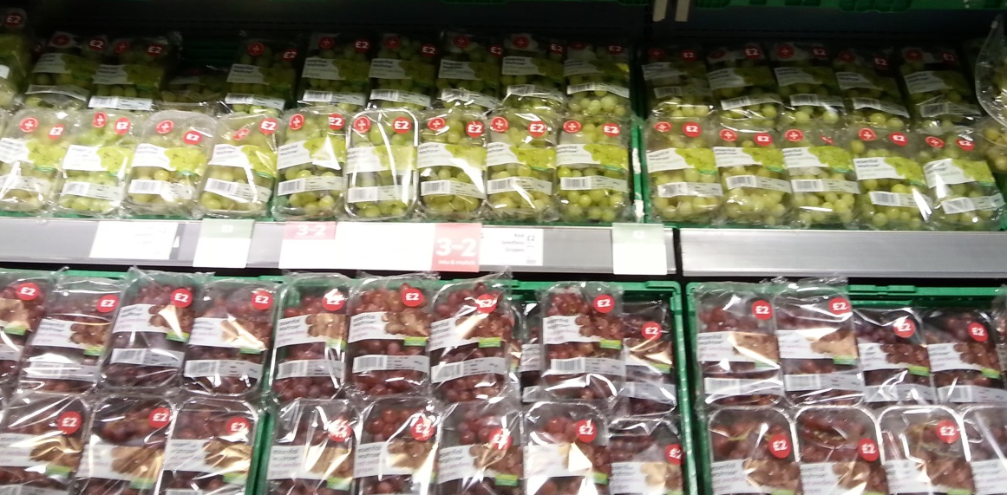
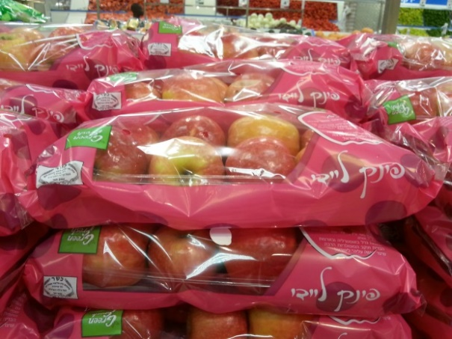
South Korea, 2014
Italy, 2015
Israel, 2021
UK, 2016

Slide 10
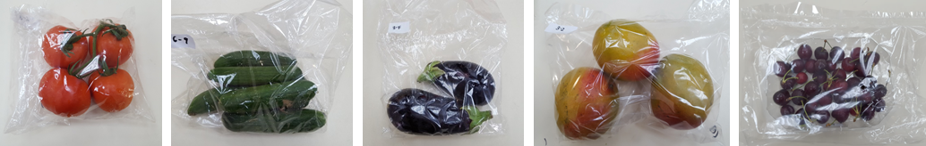
Effects of retail packaging on F&V quality
We examined the effects of various retail packages on F&V quality during simulated marketing and home storage
Wholesale
Supermarket
Home refrigeration storage
Packaging
2 d at 15°C
2 d at 24°C
1 week at 4°C
2 weeks at 4°C

Slide 11
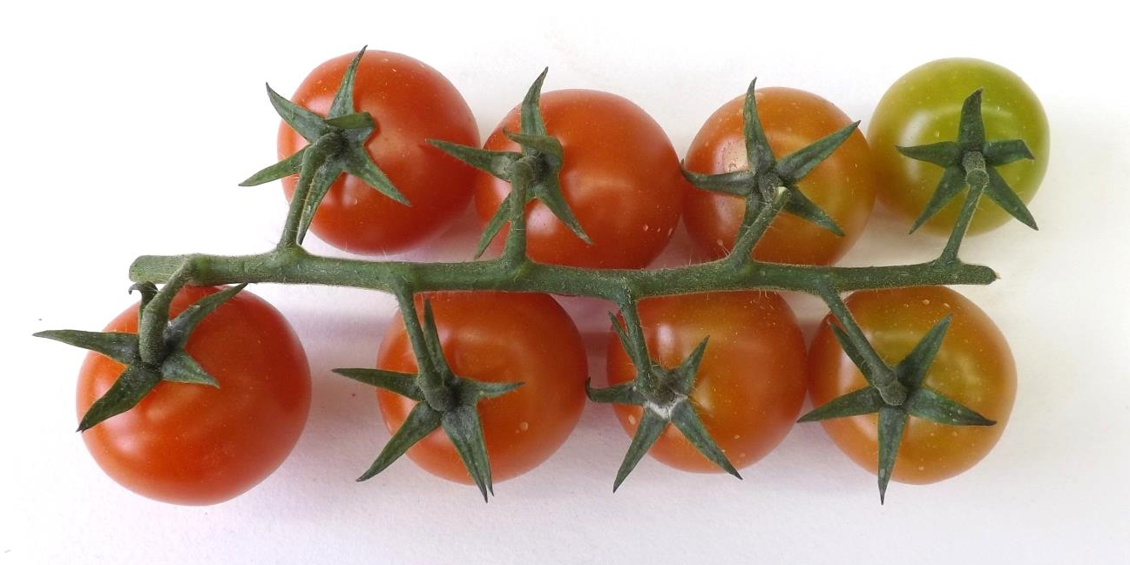
Cherry tomato
Time 0

Slide 12
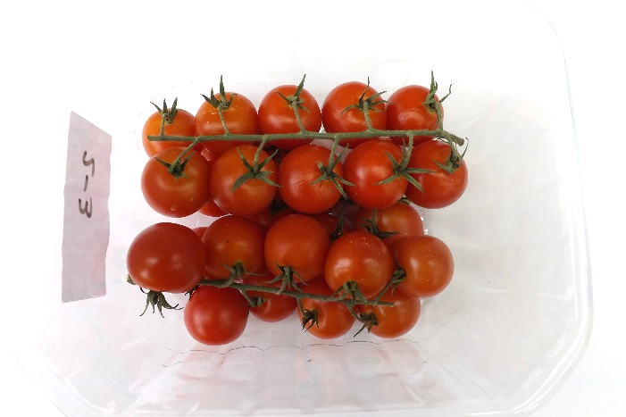
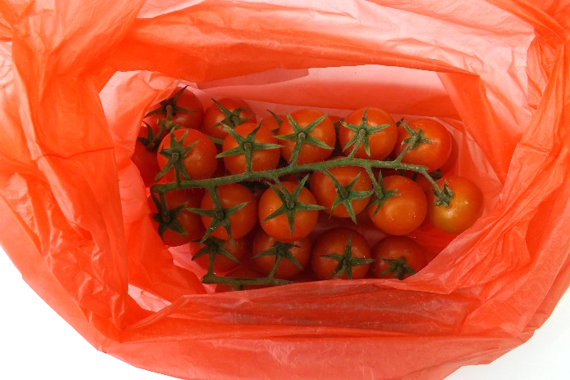
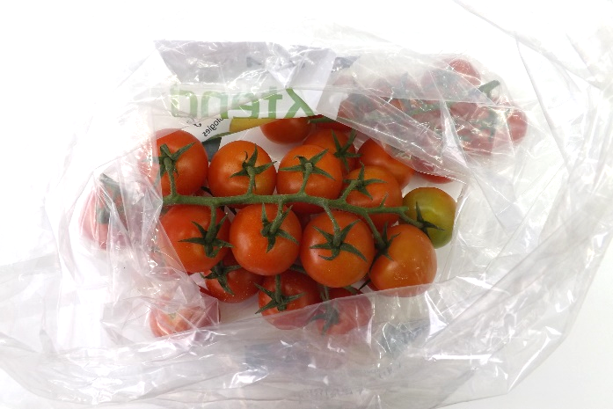
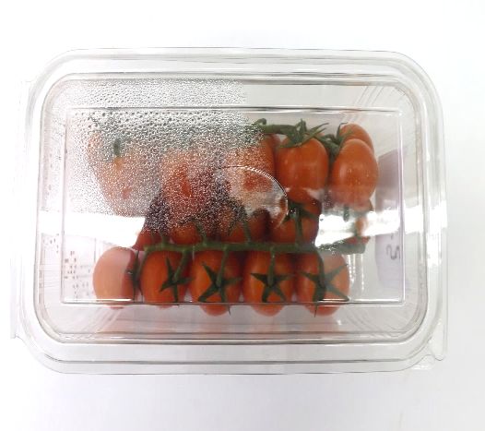
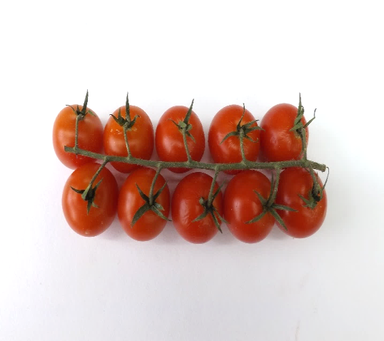
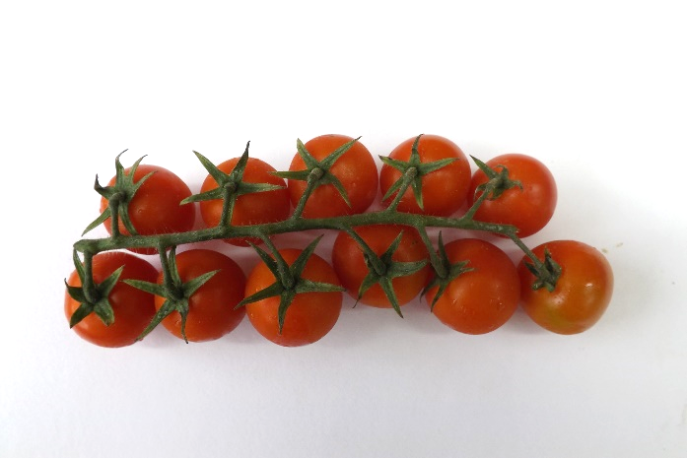
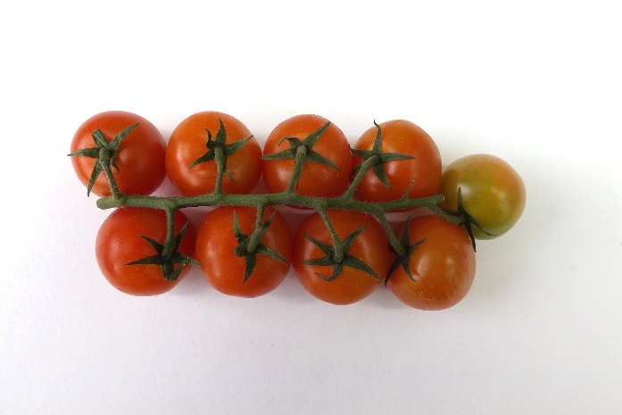
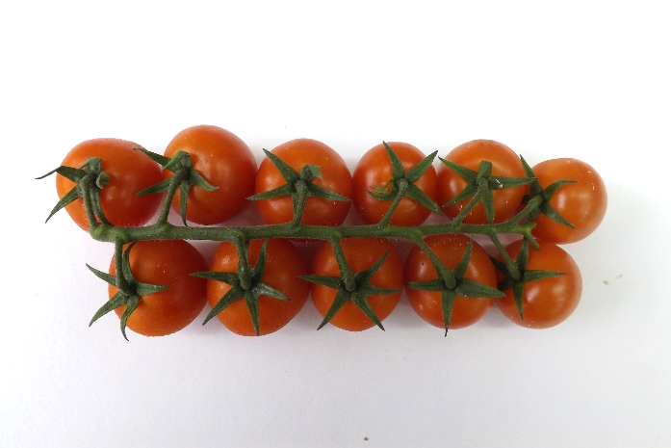
After 1 week in refrigerator
Control
PE bag
Xtend® bag
Plastic box

Slide 13
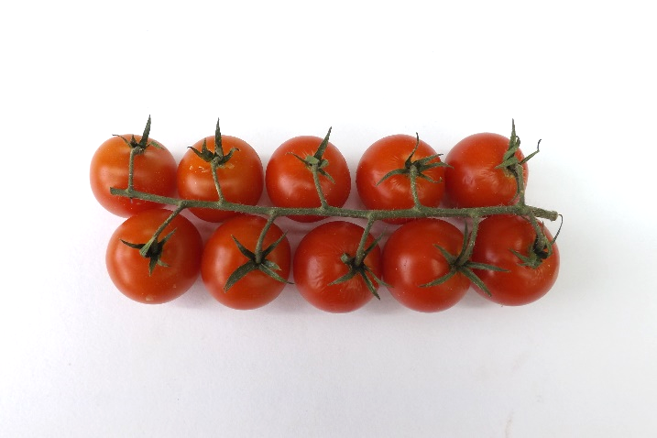
After 1 week in refrigerator
Control
Plastic box

Slide 14
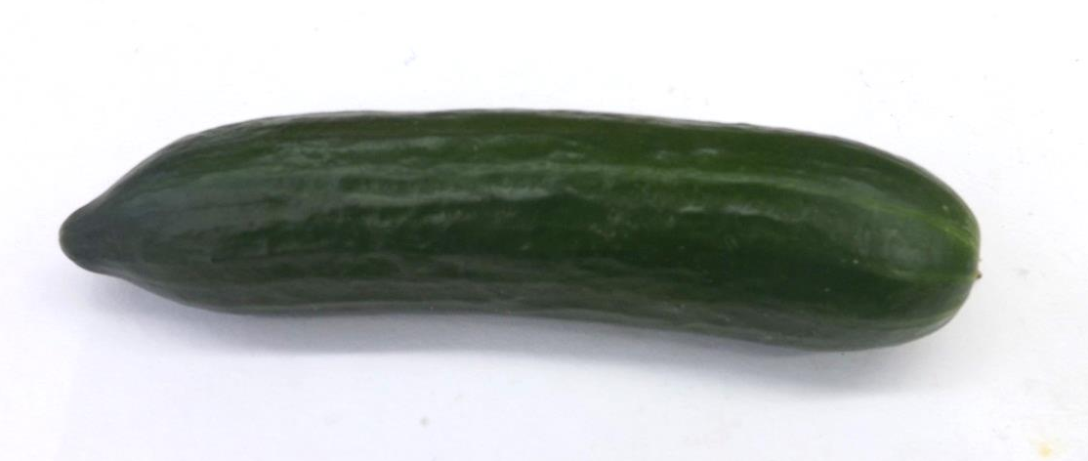
Cucumber
Time 0

Slide 15
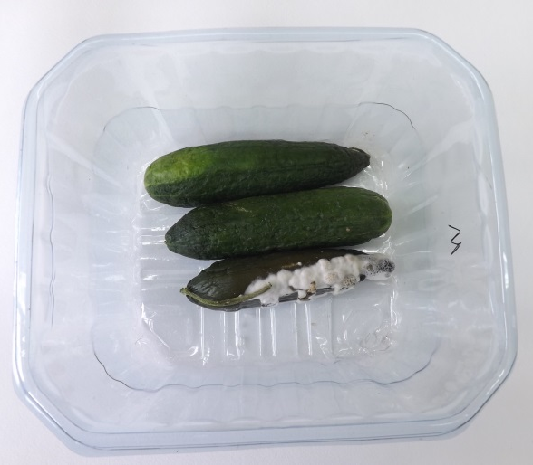
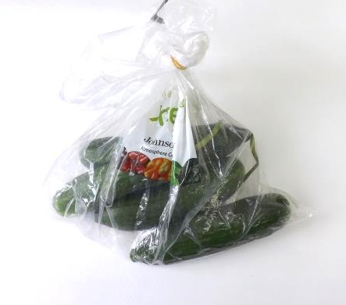
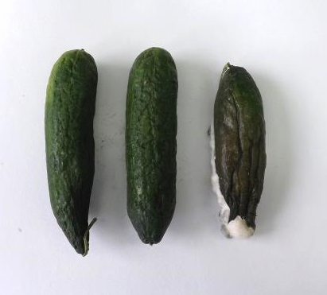
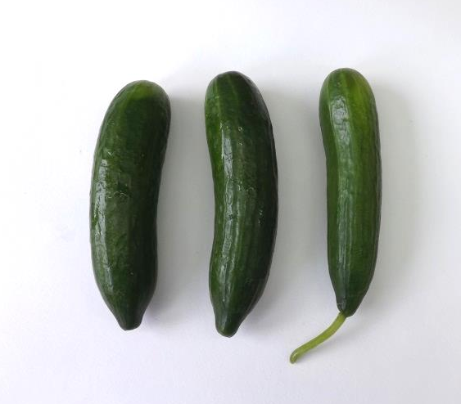
After 2 weeks in refrigerator
Control
Xtend® bag

Slide 16
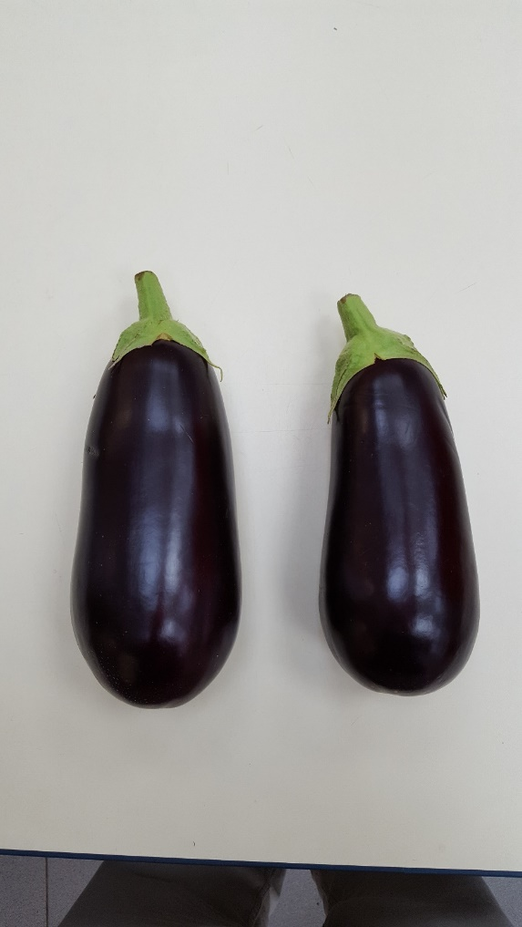
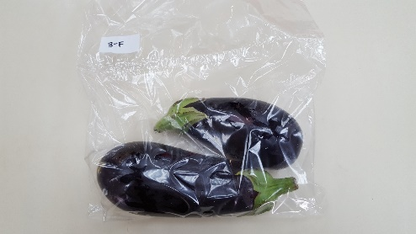
Eggplant
Time 0

Slide 17
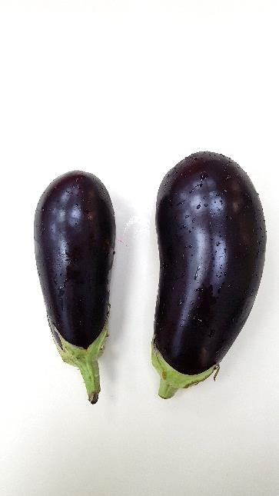
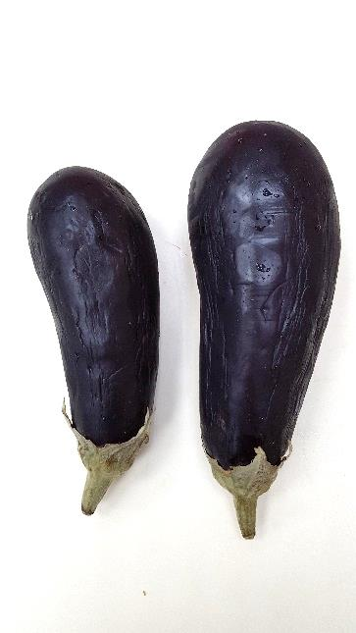
After supply chain + 2 weeks in refrigerator
Control
20 μ-perforations

Slide 18

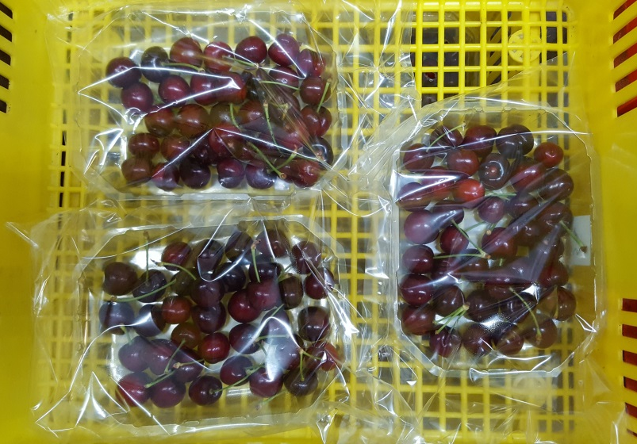
Cherry
Time 0

Slide 19
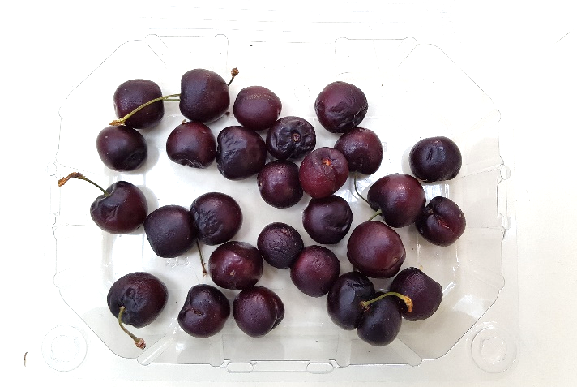
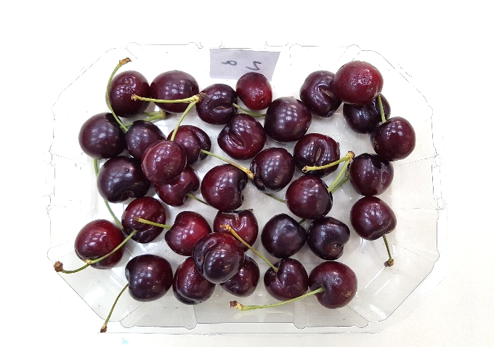
After supply chain + 2 weeks in refrigerator
Perforated box
20 µ perforations

Slide 20
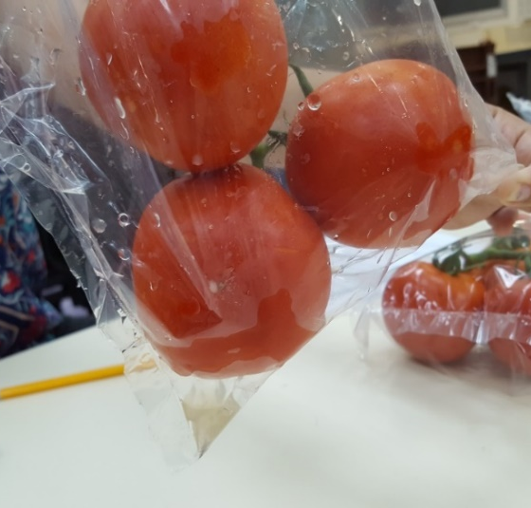
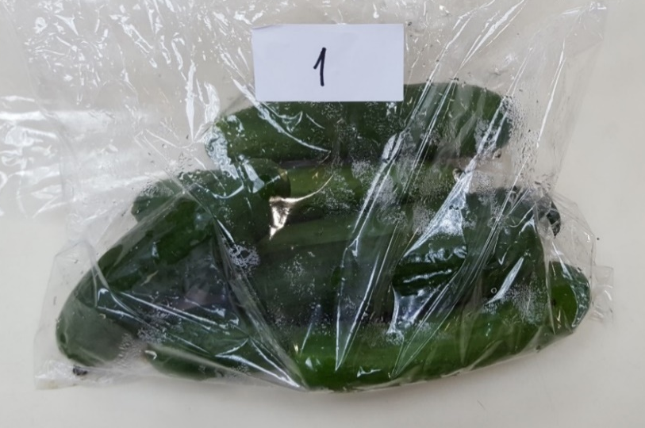
Retail packaging - conclusions
1. Optimized packaging maintains quality and reduces food losses.
2. Yet, improper packaging may cause damage (off-flavors, decay, condensation).

Slide 21
The current situation in Israel
● Since 2019 the Israeli Ministry of Agriculture is trying to promote the implementation of retail packages that retain produce quality.
● Since 2021 the Israeli Ministry of Environment is willing to accept the usage of retail packages that extend shelf-life and are suitable for recycling.
● Various types of produce are marketed in packages (Fresh herbs, cut salads, strawberry, grapes, cherry tomato, etc).
● Supermarket chains begun to sell packed produce for online orderings.

Slide 22
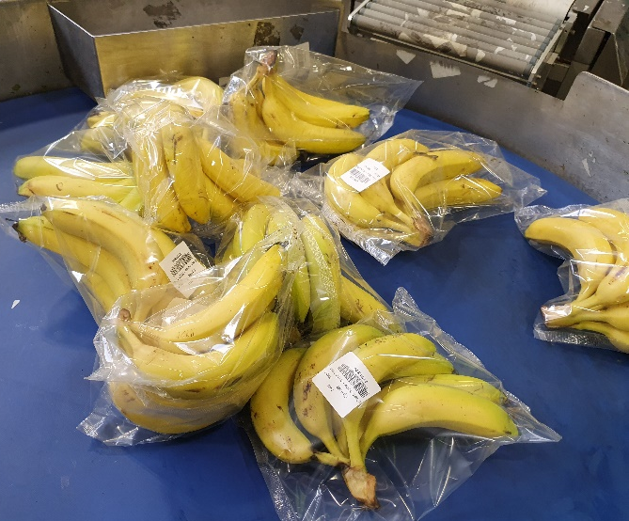
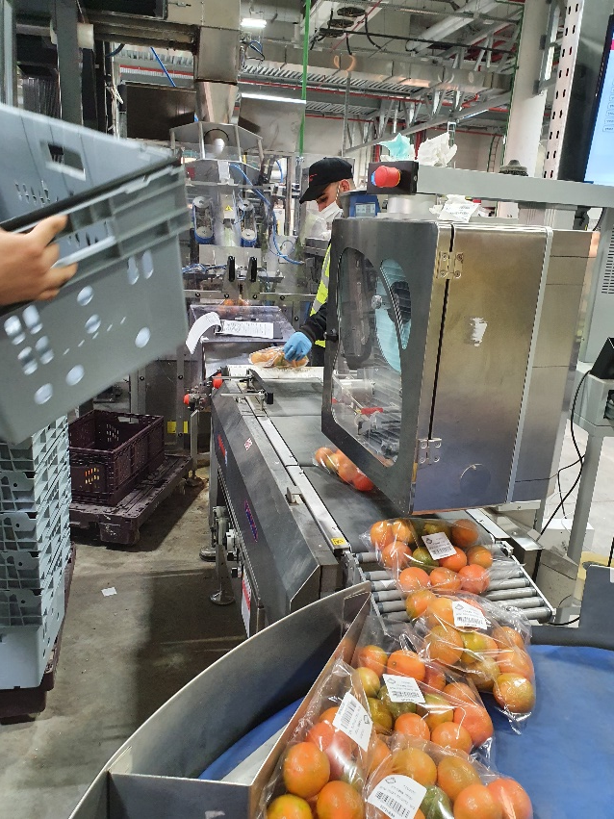
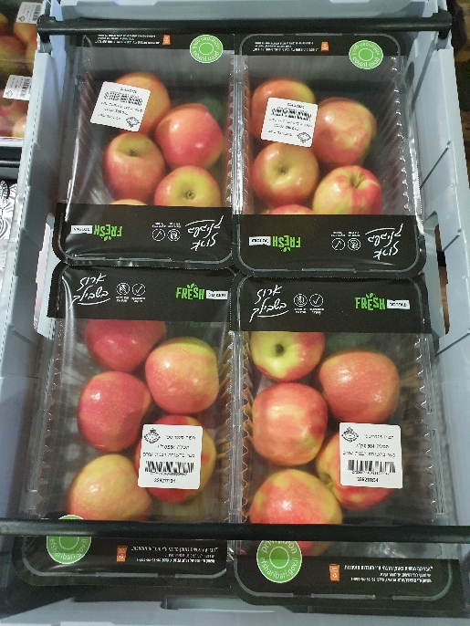
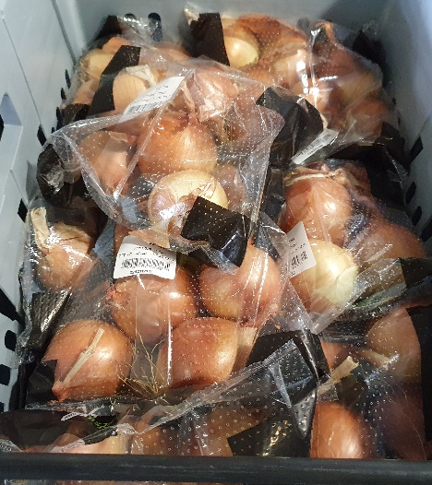
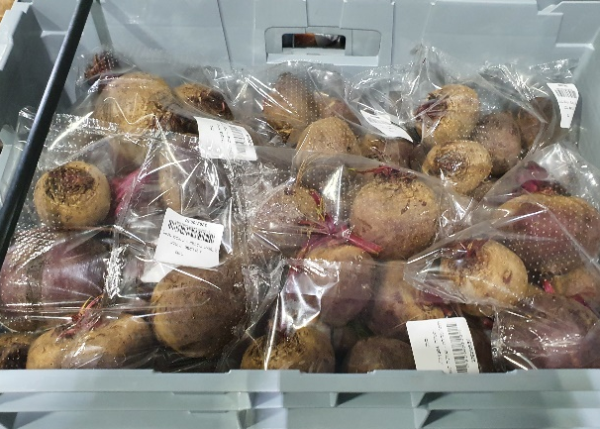
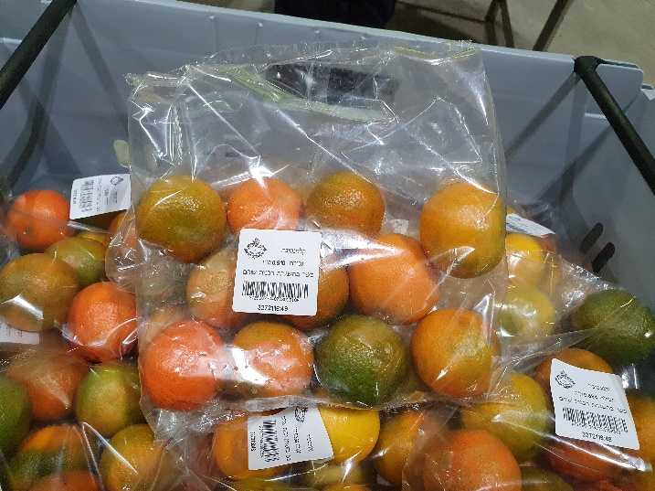
F&V packages for online marketing

Slide 23

Acknowledgments
Dr. Victor Rodov, ARO, The Volcani Institute
Thank you

