Slide 1
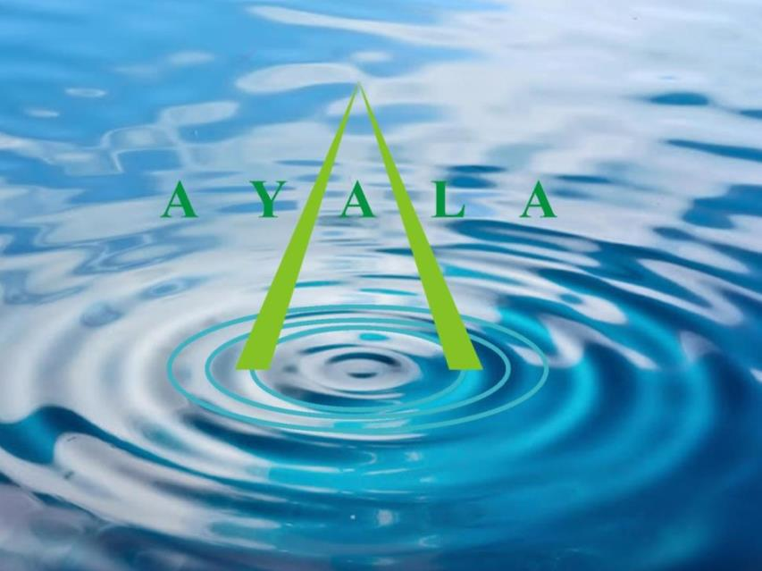

Slide 2
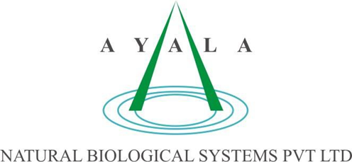
SUSTAINABILITY IN PRACTICE

Slide 3
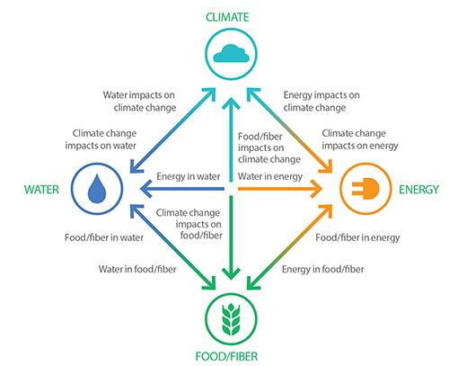
Water & Power Nexus
35%
Of Energy
Production used for Water Treatment Systems
Electricity is a per-requirement to treat water in conventional water treatment systems (STP, ETP & Desalination)

Slide 4
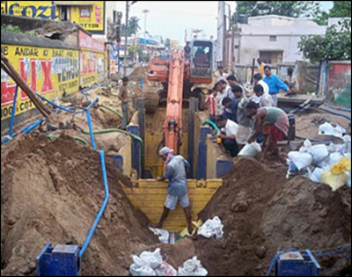
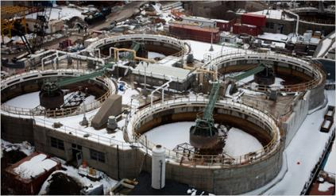
The Bottleneck Is In Our Minds & How We Use Technology
Complex infrastructure
High energy, operation and maintenance
Failures at critical moments
Difficult and expensive STP & ETP installation

Slide 5
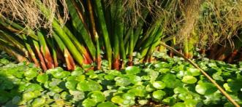
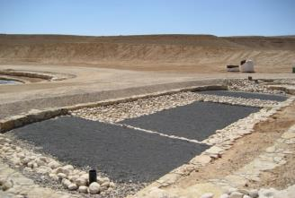
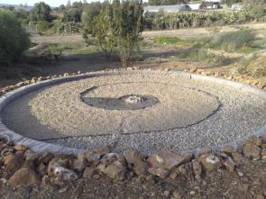
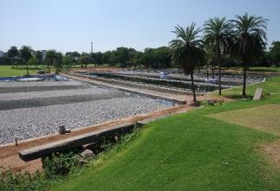
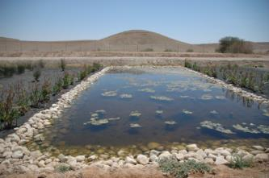
Technology Overview
Tailored, modular engineered NBS™ wetlands with proprietary hydraulics and controls
Aggregates, additives and plants customized and selected for usage for specific pollutant conditions
Multi-functional applicator systems for sludge reduction and benthic support
Biotechnology for stimulating environmental processes

Slide 6
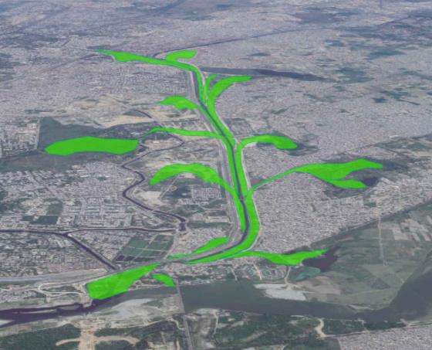
Ayala Solution : Yamuna River “Tree of Life”
Holistic Integration with the larger picture
Reimagining the public spaces
Enlivening “dead” zones
Buffering the downstream areas
Reaching and treating pollution onsite to eliminate wasteful and expensive conveyance infrastructure

Slide 7
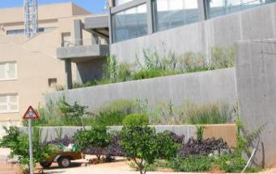
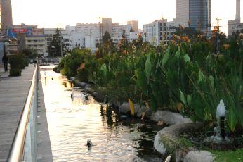
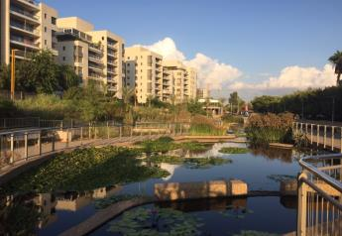
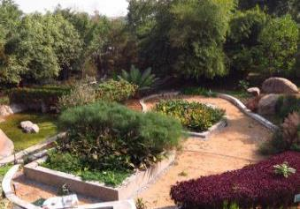
Onsite Urban Wastewater Treatment & Reuse
“Smart homes”- eco-friendly water recycling and energy efficiency
Green business centers
Ahuzat Poleg
Ampa
Recommended technology by Indian Green Building Council (IGBC)
Complete treatment and recycling of neighborhood sewage
Sobraji-Godrej
Ganei Tikva
www.ayala-aqua.com

Slide 8
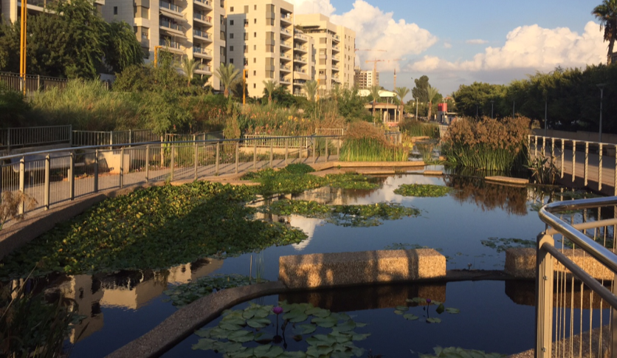
Ganei Tikvah Neighborhood Sewage Treatment

Slide 9
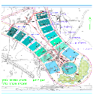
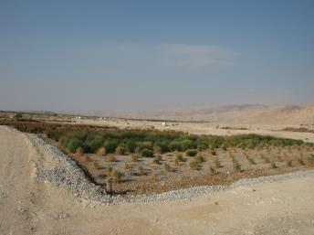
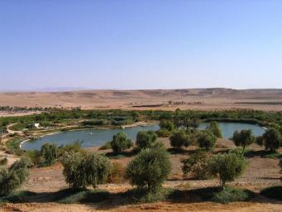
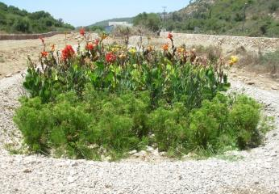
Agricultural Sewage Treatment and Reuse – Saving Farmers Millions in Sewage Treatment and Irrigation Costs
Dairy farm
Treatment of mixed agricultural effluent,
aquaculture
Neot Smadar
Lotan
Naot Smadar
Vineyard grape crush
Reuse for irrigation and recreation
Amphorae
www.ayala-aqua.com

Slide 10
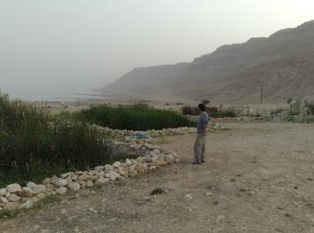
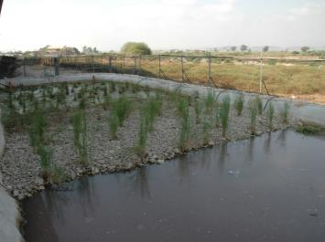
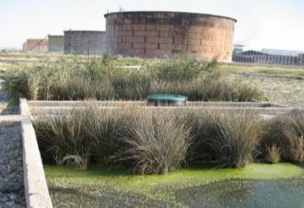
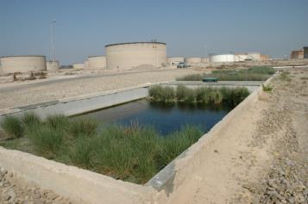
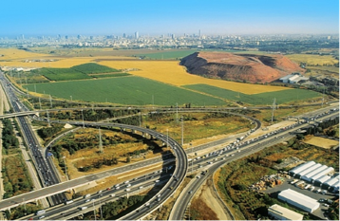
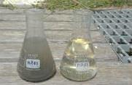
Industrial Sewage - Hydrocarbons, Heavy metals, Detergents, Salinity
Cosmetics plant
Oil factory and refinery
Influent sludge
Shemen Industries LLC
Ahava
Landfill Leachate, dumptruck rinse and run-off treatment
Petroleum container depots
Ahava
Hiriya
Petroleum Infrastructures LLC
www.ayala-aqua.com

Slide 11
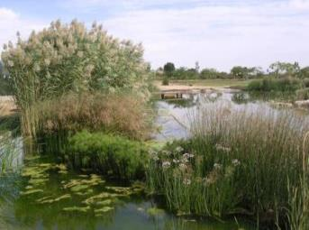
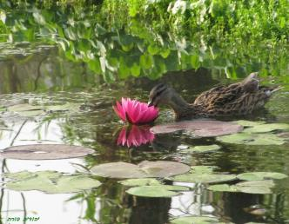
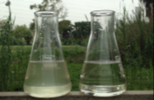
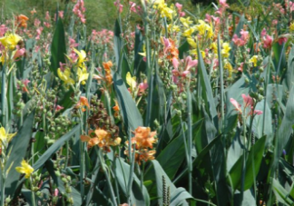
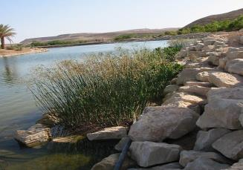
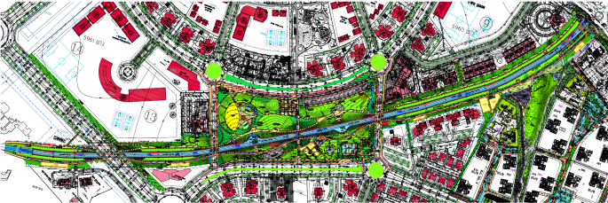
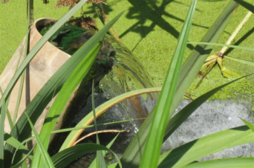
River & Lake Rehabilitation - Environmental Buffers, Stream Purification
Non-point source pollution control
Acid Mine Drainage
Industrial outflows
Riverbank and sediment stabilization
Run-off harvesting and treatment
Flora and fauna restoration
www.ayala-aqua.com

Slide 12
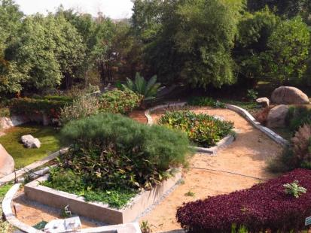
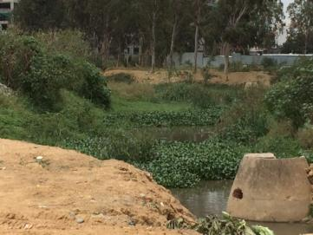
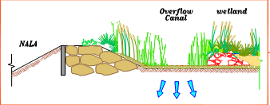
Onsite Solutions For Business & Non-Profits
Indian Green Building Council- treatment and reuse of office waste
Diyasree developers: restoration of degraded streams

Slide 13
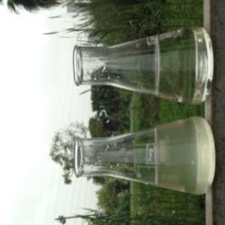
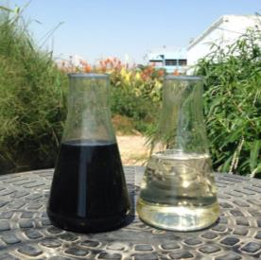
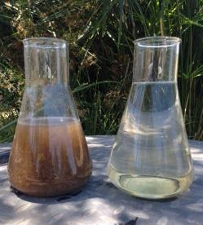
Images of Water Samples
Before & After
Pharmaceutical Discharge
Treated
Industrial Sewage Treated
Domestic Sewage Treated

Slide 14
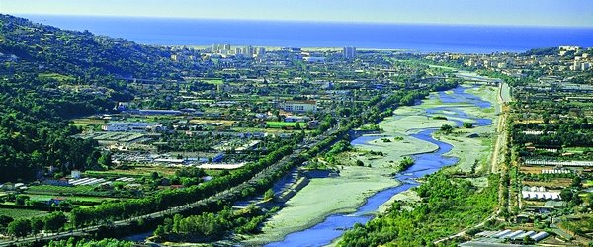
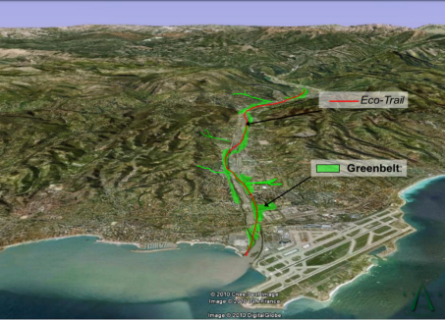
France - In Cooperation With Dutch WEST8:
Ecological Planning Of The City Of Nice & The Var Valley
Flood prevention
Protection and restoration of aquifers
Rehabilitation of local flora and fauna
Improvement of air quality
www.ayala-aqua.com

Slide 15
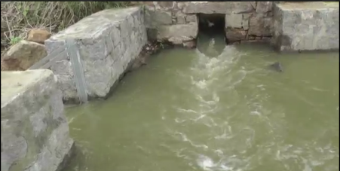
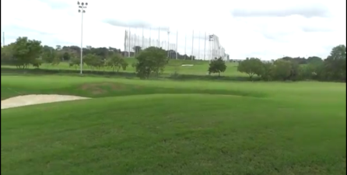
How To Turn A Liability Into An Asset ?
Hyderabad Gold Course irrigation requirement of
2 MLD for Landscape and Lawn care
Nearby urban effluents 3-5 MLD
Shortfall of 2MLD irrigation water

Slide 16
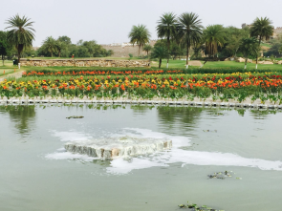
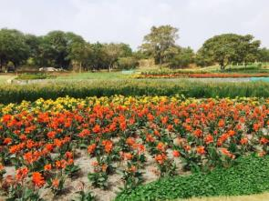
The NBS™ Wetlands at HGA
The Natural Biological Systems - Active Landscape has helps recover 4 MLD of water for the Irrigation of Hyderabad Golf Course

Slide 17
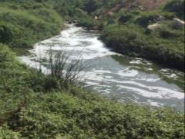
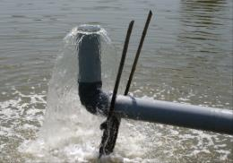
Summary: The Natural Biological System™ at HGA
4 MLD Capacity in 7000 m²
~300K USD Capital Cost
4 months implementation
Saves 2 Million Liters Irrigation Water Daily
AND:
Local labor & resources
Minimal maintenance
Zero-energy treatment
Raw sewage from Satam Cheruvu overflow
The Natural Biological System™
Tertiary Quality Outlet
Diversion to NBS™
Subsurface Flow

Slide 18
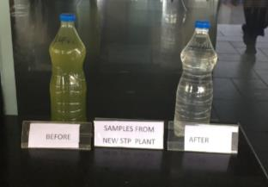
Testing by Care Labs, Hyderabad

Slide 19
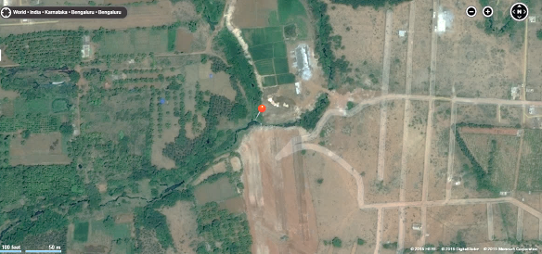
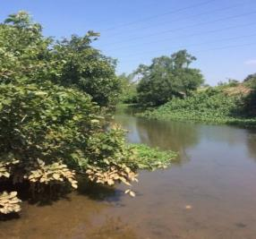
Current State Of Arkavathi River – Sewage Influence An Ongoing Catastrophe To TG Halli Watershed
Arkavathy River prior to confluence with nalla
Perrenial Urban Sewage Flow (15 MLD)

Slide 20
India: Protection & Rejuvenation Of Arkvathi River From Hesaraghatta Lake To TG Halli Reservoir, Bangalore
TG Halli - Reservoir under danger of collapse
Arkavathi & Kumudavathi Watershed
Year Established | Max supply (MLD) | Actual supply (MLD since 2012)
1933 | 135 | 0
Rural and agricultural run-off
Arkavathi River
Bangalore sewage outflows
TG Halli

Slide 21
Solution: Treating The Perennial Sewage Flow Without Affecting the River Channel
Revitalized waters
NBSTM engineered wetlands
Diversion to side canals
Water flow
Work in Progress

Slide 22
The Ganga River Basin - Where All Conventional Solutions Have Repeatedly Failed
Flooding
Reduced flow
Infiltration of >6 billion litres/day raw sewage

Slide 23
APPENDIX: Case Studies
Landfill Leachate
Petroleum Tanker Bilge Water
Urban Wastewater Treatment

Slide 24
Case #1: Landfill Leachate & Dumptruck Rinse Treatment
The Site & The Challenge
Hiriya was Israel’s main refuse disposal site, 1952 to 1998- now a sorting center for 2700 tons of waste, daily
16 million tons of refuse continue to decompose after cessation of activity at the site
Leachate is mixed with the site’s domestic sewage, dump truck rinsing water and with local runoff Together they make up extremely difficult waste:
Highly saline (up to 5000 mg/L chlorides)
High organic loads
Heavy metals
Fats and oils
The site’s entire treatment needs (up to 80 m³/day) are economically and ecologically met by the NBS (5 treatment ponds, total 240 m²) designed and installed by AYALA in 2006

Slide 25
NBS @ Hiriya: A Model For Sustainable Treatment Of Landfill Waste
Schematic sign at the educational center
NBS @ Hiriya-over 10 yrs (and counting) of smooth operation
Results (Avg 2008-2010)
Parameter | Avg Inlet (Highest Value) | Avg Outlet | Percent Removal
BOD (mg/l) | 4113 (29,360) | 15.3 | 99.6%
COD (mg/l) | 13,677 (114,110) | 181.4 | 98.6%
TSS (mg/l) | 9,155 (87,925) | 16.14 | 99.8%
E. Coli (CFU/100 mL) | 5.7 X 10⁷ (10⁹) | 1.4 X 10⁴ | 99.98%
T-N (mg/l) | 284.3 (1700) | 50.6 | 82.2%

Slide 26
Case # 2 Petroleum & Energy Infrastructures (PEI) –
Treatment Of Water With High Levels Of Salinity, Hydrocarbons, Detergents & Emulsions
During the transportation of crude oil & during the transfer process, sea water infiltrates the oil and needs to be separated
The recovered water contains hydrocarbons, heavy metals, minerals, emulsions, fats and oils & a high salinity level of up to 25,000 mg/l chlorides that is more than half the salinity level of seawater
Before the recovered water can be returned to the sea, hydrocarbons, and other materials harmful to the environment must be removed
Ayala was approached because of the company’s experience and proven record of dealing with wastewater and runoff in gas stations and army camps

Slide 27
NBS - Safe & Natural Tailored Treatment Of Hydrocarbon
& Metals Contaminated Seawater
Ayala set up an extensive NBS facility with an array of hydrological and biological components
The NBS operates continuously, under all types of weather and with no maintenance
The system removes organics, metals, oils and fats, emulsions, etc at highly impressive rates with no energy input
Operating since 2007, the system treats 12 m³/day in 3 treatment ponds, totaling 100 m²

Slide 28
Case # 3 – Urban Sewage Treatment
& Reuse
Ganei Tikvah- 550 residential units
Water & Energy shortages, infrastructure demands & other considerations are making onsite sustainable sewage treatment a necessity in many regions
AYALA has the most developed models with on-the-ground experience in the field & has been safely & effectively treating domestic sewage with NBS for over 26 years
AYALA’s NBS meets the strictest regulations in the world for sewage treatment in populated areas: no odors, no pathogens & no exposed water during the treatment process
Reclaimed water is used for irrigation & is safe for incidental consumption

Slide 29
THANK YOU

